Slide 1
“You Need to Prove That What You Say Is True”: Patient Experiences with Urine Drug Testing in Buprenorphine Treatment
Andrea Jakubowski, MD, MS
Isabel Lamont, BS
Teresa Lopez- Castro, PhD
Tiffany Lu, MD, MS
Shadi Nahvi, MD, MS
Mariya Masyukova, MD, mS

Slide 2
Conflicts of interest
Nothing to declare

Slide 3
Background
Urine drug testing (UDT) is routine in primary-care-based buprenorphine treatment.
UDT carries increased risks for vulnerable populations (justice-involved, pregnant or parenting)
Few studies have examined patient experiences with and perceptions of benefits vs. harms UDT
“Necessary and sensible” vs. “Insulting, invasive, and unnecessary” (Wyse, 2020)
Black patients are more likely than white patients to undergo UDT (Becker, 2011; Peterson 2023)
Notes:
Mixed opinions

Slide 4
Objectives
Examine patient:
Experiences with UDT
Perceptions of UDT benefits and harms
Choice in UDT
UDT preferences and recommendations
Data→ Toolkit on equitable UDT
Notes:
We are using these and other data to develop a toolkit for patients and providers on equitable UDT

Slide 5
Methods
Setting: Academic Medical Center
FQHC
SSP-based clinic
In-depth qualitative interviews
Eligibility criteria
18+ years of age
Opioid use disorder
Completed UDT in buprenorphine treatment within the past 5 years
Purposive recruitment: currently receiving & not currently receiving bupe treatment

Slide 6
Methods
Analysis
Hybrid rapid qualitative and thematic analysis
Interview transcripts extracted into templates
Neutral/Negative/positive valence
Templates collated into a matrix for analysis
Memoing, theme mapping

Slide 7
Results
Patient characteristics (N=28)
Gender | Male: 61%
Age | Mean: 50 years Range: 29-75
Race/Ethnicity | Latino (any race): 40% Non-Latino white: 32% Non-Latino Black: 21% Non-Latino Mixed Race (Other): 4%
Recruitment Site | FQHC: 46% SSP: 54%
Currently receiving bupe treatment | 46%
Currently using Non-Rx Opioids | 43%
Notes:
IL

Slide 8
Thematic map
shame
pride
stigma
Continuum of negative experiences
Continuum of positive experiences
Tx consequences
motivation
Therapeutic conversations
Hospitality
physical discomfort
Mistrust
Judgment
information
Patient/Provider relationship
Treatment Disengagement
Treatment Engagement
Notes:
-I want to show how our themes connect before diving into the details.
-We identified a continuum of both negative experiences and positive experiences, and the Patient/Provider relationship strongly influenced the type of experience the patient had.
-Patient/provider relationships characterized by mistrust were associated with negative experiences which led to treatment disengagement.
-Whearas patient/provider relationships...

Slide 9
Continuum of negative experiences
Carceral
Observed testing
“it’s pretty much sexual assault”
--EmTtOc
Clinically detrimental consequences
“Your [bupe] level would get dropped. Like if you were taking three a day… you might get dropped down to two, you might get dropped out altogether…if you're on parole they're going to have to tell your parole.”--IeAnJu
“And if I had certain things in my urine, I wasn't getting my Suboxone, which I don't understand. You were worried about me overdosing on heroin. So, why would you stop my Suboxone?”
-RdAnAu
Notes:
Carceral- patients described being reincarcerated for a single positive UDT. They also described very invasive experiences of observed urine drug testing. But this wasn’t just in carceral settings, patients described invasive observed testing experiences in outpatient buprenorphine and detox facilities as well.

Slide 10
Continuum of negative experiences
“at times it was embarrassing or belittling.”
-EyDoFe
“there's usually some anxiety involved.” -LeEzJu
Physical discomforts with UDT
Patients who have difficulty urinating
Prostate issues
Shy bladder
“if the doctor sees those results and they judge you then… the user uses more.” -RyOnAu
Emotional impact
Shame
Embarrassment
Anxiety
Judgment
Demoralization
“they'll be embarrassed of what they find in their urine .”
-TyTaMa
Notes:
and I want to highlight the bottom left quote, illustrating how patient/provider relationship characterized by provider judgment leads to negative experiences and disengagement

Slide 11
Thematic map
shame
pride
stigma
Continuum of negative experiences
Continuum of positive experiences
Tx consequences
motivation
Therapeutic conversations
Hospitality
physical discomfort
Mistrust
information
Patient/Provider relationship
Treatment Disengagement
Treatment Engagement

Slide 12
Continuum of positive experiences
Pride
Motivation
Accountability
Harnessing UDT
“[My doctor] told me that I was good. Keep up the good work. He boosts me up just to stay clean and that's what I done.”
-PhThAu
“I thought I was shooting heroin but I got like 7 different kinds of drugs in me. Crazy.”
-GeThMa
“Trying to strive to not test positive for anything and knowing you haven't gotten high and knowing you're going to have a negative test…you feel a sense of accomplishment”
-EyTeMa
Notable finding: few reports of positive interactions w/providers when UDTs +/unexpected results
Notes:
indicating that these positive experiences were contingent on the patient being abstinent.
3 pts who had positive experiences (positive/expected; belief about false positive; unqualified positive)

Slide 13
Thematic map
shame
pride
stigma
Continuum of negative experiences
Continuum of positive experiences
Tx consequences
motivation
Therapeutic conversations
Hospitality
physical discomfort
Mistrust
information
Patient/Provider relationship
Treatment Disengagement
Treatment Engagement

Slide 14
Patient-provider relationship
Patient-provider relationship significant contributor to patient’s overall experience with UDT
“if eventually you build some kind of trust with your provider …and a mutually respectful relationship, I don't see that people would necessarily decline it or not want to do it. ... If it's constantly like waving a carrot over you, it feels like it actually pushes more people away from treatment”
-NaOvJu
“[UDT] doesn't really bother me. Like I said, if I'm fucking up, I would just tell him”
–GeThMa
Notes:
1st quote: This quote also illustrates aptly the idea of negative experiences leading to treatment disengagement
2nd quote: Within a positive relationship where patients feel comfortable talking to their providers about their drug use, UDT is more acceptable to patients

Slide 15
Patient-provider relationship
UDT carries a range of meanings within the patient/provider relationship
(-) UDT is the doctor trying to make money
(-) UDT reveals lack of trust
(+/-) UDT currency in patient-provider relationship
(+) UDT demonstrates the doctor cares
“We don't believe you. You need to prove that what you say is true.”
-MyNiSe
“It makes a better relationship with the doctor.”
-EmTtOc
“They look after
you, (they’re) trying to look out for your well-being.”
-CkErDe

Slide 16
Choice: patient experiences
Lack of Choice
False Choice
“It's not so much a choice. It's like, look if you want your Suboxone…”
-RdAnAu
“You take the test or you're not gonna get supplied with suboxone, period”
-CkErDe
Notes:
Just 3 patients had a choice

Slide 17
Patient recommendations
“Hospitality to the people”, patient consideration, attention to privacy
Individualized testing approach
Provide patients with results! And counsel about risks
No negative consequences for UDT results
“if the person that's giving it helps me drop my defenses, I won't feel like I'm hiding something. I feel comfortable giving the person the urine.”
-AlAwMa
“I mean, I think they should give them a choice, but they should also let them know the risks”- RyOnAu
Notes:
individualized matrix, substances, frequency,

Slide 18
Conclusions
Patients identify benefits of UDT
To maximize benefits and minimize harms of UDT, providers can:
Foster trusting patient/provider relationship based in non-judgment
Avoid making treatment decisions on basis of UDT-alone
Offer patients choices
Be mindful of patients’ possible prior negative experiences

Slide 19
Acknowledgements
MariYa Masyukova, Isabel Lamont, and Study team
Joe Deluca
Brent Gibson
Susan Spratt
Other SSP staff
Our patients

Slide 20
Gender differences in UDT
“That's why I wouldn't even go to, like I said, I wouldn't even go to my PCP for something like this, because ultimately, if I went to my PCP and I said, hey, I'm pregnant, I'm trying to get cleaned up. I'm trying to do the right thing for this baby. Help me find a safe alternative, it would be ultimately being looked down on and judged. I already know that. I've had so many of those experiences. The experiences that aren't stigmatizing are so few in between.”-NaOvJu
“For other things, it was ACS mandated or court mandated things like that. So they made the decision . . . For ACS and everything else it was like get a text message and be like, please submit to a random tox today.”-EyDoFe

Slide 21
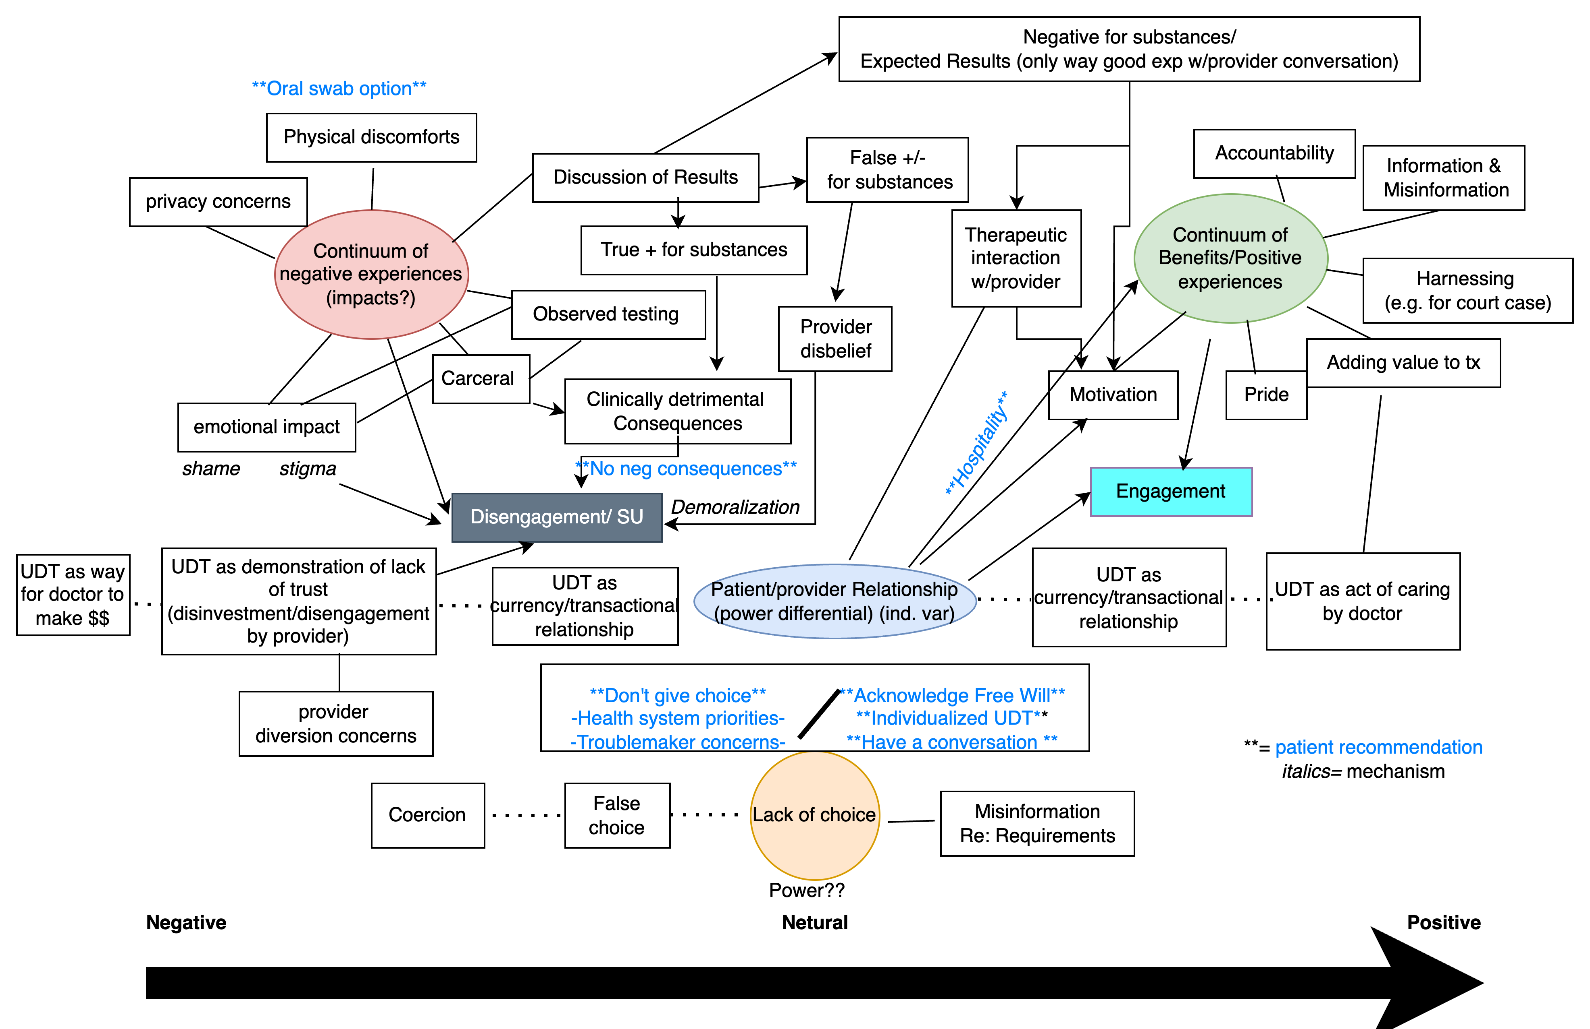
Thematic map

Slide 22
Choice: patient recommendations
Should patients be given a choice to do UDT?
Should not be given choice
Health system priorities
Trustworthiness
Acknowledge free will
Individualized UDT
Counsel about risks
Drug testing options
“You can't just force somebody if you're peeing in the cup or not”
-EmTtOc
“lt’d be just a waste of money, insurance gotta pay for that, taxpayers pay for that, so you can save people some money by not giving [bupe] to that person, because he's not taking it, he's reselling them”-CkErDe
“I mean, I think they should give them a choice, but they should also let them know the risks”- RyOnAu
Notes:
Mass manipulators, liars, selling their bupe

