Slide 1
“You Want to Know the Person That's Lying There”: Patient Experiences of Hospital-Based Care after a Stimulant-Related Overdose
Isabel Lamont, BA
Teresa Lopez-Castro, PhD
Shadi Nahvi, MD, MS
Mariya Masyukova, MD, MS
Notes:
Good afternoon everyone, my name is Isabel Lamont. I'm a research coordinator at Albert Einstein College of Medicine and a pre-health student, and I'm so excited to be sharing this research with you all here at AMERSA.
Today we will be talking about stimulant-related overdoses and our qualitative project that focused on patient experiences of such overdoses and the care they received in the hospital after.

Slide 2
No financial conflicts of interest to disclose.

Slide 3
Background
The number of stimulant overdose deaths involving synthetic opioids other than methadone (primarily fentanyl) has risen since 2014. (Jones and McCance-Katz, 2019)
The number of deaths involving stimulants has increased steadily since 2014 regardless of opioid involvement. (Mattson et al., 2021)
For cocaine-related deaths from 2017-2020, mortality trends significantly increased for Black, Hispanic, and Indigenous populations (Yunusa et al, 2023)
Little qualitative work around risks and prevention of stimulant-involved overdoses
Notes:
In the past decade, we have notably seen the number of stimulant overdose deaths involving synthetic opioid co-use (mostly fentanyl) increase, as well as an increase in overdose deaths involving stimulants only.
It is critical to note that there are health disparities at play here with the population of Black individuals in the US experiencing the sharpest increase in stimulant-involved overdose deaths, followed by Hispanic and Indigenous populations, respectively. It is as important to acknowledge that this significant increase among marginalized racial identities does not indicate a "sicker" population by virtue of their identity, nor can it even be solely explained by rates of past year cocaine use in each group. Instead, these rising numbers are symptomatic of deeper health disparities relat ed to drug use that we have historically seen in marginalized groups (for example, crack vs. powder cocaine sentencing, contrasting responses to the crack epidemic in the 1980s vs. Opioid epidemic of the 2000s).
We now have a strong repertoire of studies focusing on contextual factors related to opioid overdoses, and the interventions we currently use for reducing overdose risk are centered around opioid overdoses.
Qualitative research can be a key resource in addressing issues of equity by centering the experiences of patients and learning from them. We don't have much in the way of qualitative work to help us understand the unique risks of stimulant overdoses, nor do we have much in the way of understanding how to prevent and care for stimulant overdoses.

Slide 4
Project aim
To examine the perspective of patients who experienced a stimulant-involved overdose on the care they received in the emergency department or hospital after the overdose.
To use these patient experiences to inform how hospitals can optimally prevent and respond to stimulant-involved overdoses.
Notes:
Our goal in this project was to better understand how people experience stimulant overdoses, and use these experiences to help inform how our hospitals can best respond to and prevent stimulant overdoses.

Slide 5
Methods: Participants
Inclusion criteria
Adults 18 and over
Experienced a hospitalization or ED visit due to a stimulant-involved adverse event
English speaker
Qualitative interview (30-45 minutes)
Phone, in-person
$30 ClinCard compensation
Interview guide examined patient perspectives and risk setting of overdose/hospitalization
Recruitment sources
Montefiore Addiction Consult Service
Database of large urban healthcare system
Notes:
We were looking to interview English-speaking adults over 18 who had gone to the hospital or ED due to an adverse effect of stimulant use.
We developed an interview guide that asked patients about their experiences with stimulant overdose and perspectives on the care they received in the hospital after. Our interview guide was informed by theoretical writing in this area about what influences stimulant-related harms, in particular the Rhodes Risk environment framework.
In order to get a sampling that was representative of the people who get care in our system, we recruited from the Montefiore Addiction Consult Service and a de0identified healthcare database from a large urban healthcare system.

Slide 6
Methods: Recruitment and Screening
Letters sent to patients from Addiction Consult Service List and CFAR Database
Interested participants call PI’s phone number included in letter
Complete informed consent and screener with potential participant
Schedule qualitative interview with participant
Notes:
We employed a traditional recruitment method of sending OPT-IN letters to patients from our two database sources and conducting follow-up phone calls after letters were sent.

Slide 7

Methods: Defining stimulant-involved overdoses for health database
Two groups identified:
  Depressive overdose group
    ICD opioid overdose code
    Urine/serum toxicology results with stimulant use indicated
    Stimulant-related diagnosis code (below)
  “Overamp” non-opioid stimulant overdose
    “cocaine poisoning’
    “poisoning by psychostimulants”
    “cocaine abuse with cocaine-induced psychotic disorder
Image: nextdistro.org/resources-collection/overamping-stimulant-overdose
Notes:
We defined two distinct groups of stimulant-involved overdoses: opioid or depressive overdoses and overamps.
"Overamp" is a term used to describe an adverse effect due to excessive use of a stimulant. These are different from the depressive, opioid-forward overdoses involving stimulants. Overamps are distinct from depressive overdoses symptomatically, and are usually characterized by things like chest pain, extreme anxiety, shortness of breath, and breaking out into cold sweats.
When we requested our data pull, we defined the two group using ICD codes. For depressive stimulant-involved overdoses, we used the ICD opioid overdose code in addition to either urine toxicology results with stimulant use indicated or one of the stimulant-related codes, including "cocaine poisoning," "poisoning by psychostimulants," and "cocaine abuse with cocaine-induced psychotic disorder.“ For overamps, we identified them using the solely the stimulant related codes.

Slide 8
Results
Notes:
Now we can get into our results.

Slide 9
Results: Recruitment Flow and Screening
270
494
22
10
Letters sent to eligible patients from EHR databases
Calls to potential participants by project RA
Potential participants screened
Consented and scheduled for qualitative interview
Notes:
In practice, we sent out 270 letters, and then each potential participant was called roughly twice. We screened 22 individuals and ended up consenting and scheduling ten of them. – reasons for screening out included individuals denying that they used stimulants, denying having experienced a stimulant-involved OD/AE, denying going to the hospital or seeking medical attention after stimulant-involved OD/AE.

Slide 10
Participants (n=6)
Table 1: Participant characteristics
Age | 47 years (mean)
Race/Ethnicity Black/African American Asian America/Pacific Islander Latino/Hispanic | 1 1 4
Gender Men Women | 4 2
Notes:
Ultimately, we completed, transcribed and analyzed 6 interviews before we closed recruitment.

Slide 11
Emerging theme 1 (n=6): Notable difference between depressive overdose and stimulant-forward overdose
Depressive Overdose | Stimulant Overdose
Not conscious at time of OD– other people seek medical attention “When I woke up, I was in the middle of the floor, EMTs foot on me, and they told me I overdosed. And that’s when it dawned on me” | Can be self-directed help seeking or by other people “I kept running and running to the hospital. I felt something was wrong with me. Like psychiatry, I thought something was wrong with me. . . I [felt] like I'm smoking too much. I want to get out of this cycle.”
Notes:
We saw a spectrum of experiences in the ED from our interviews, with some people being known, repeat encounters and others leaving the hospital as a closed door they will never return to. We interviewed both patients who experienced depressive overdose and patients who experienced stimulant-only overdoses, illustrating the distinctions between these two presentations of overdose. While the depressive stimulant-involved overdoses presented similarly to opioid-only depressive overdoses, the presentations for a stimulant-only overdose were more varied. With depressive overdoses, the individual has little to no agency in seeking hospitalization since they will likely be unconscious at the time of OD. However, with stimulant-overdoses, there is no one presentation—people may experience psychiatric symptoms or cardiovascular symptoms, seek care themselves, or another individual will make the decision to seek medical care—it can look different for different people.

Slide 12
Emerging theme 2: Psychological/psychiatric and behavioral impact of stimulant use
[Stimulant use] exasperated a lot of mental issues I had.
It was affecting my mental health. I felt like I was in a bad state of mind. I felt like people, places and things were all getting at me. I felt like a dog against a wall. It was just horrible. I was like, "Oh, no, I got to get myself out of this."
My mood swing was definitely off the meat rack. I never had a stable mood.
Notes:
The psychological and behavioral impact of stimulant use was a recurring topic among interviews. For one interviewee, this is the reason she sought medical care after stimulant use. Other interviewees note this as well.

Slide 13
Emerging theme 3: Hospitalization uncovering deeper health issues
My chest was hurting. Then they found out I got congestive heart failure, then they found out I got emphysema, that you're not breathing properly, because you got emphysema. You smoke too many cigarettes.
Uh, they said there was something wrong that my heart was leaking some kind of fluid and they had to keep me on observation . . You know, I'm still a healthy person, but one of the times that I overdosed I did have liver failure and kidney failure.
Notes:
When discussing patients' experience in the ED, there were instances that the patient discovered serious health issues during their post-simulant hospitalization.

Slide 14
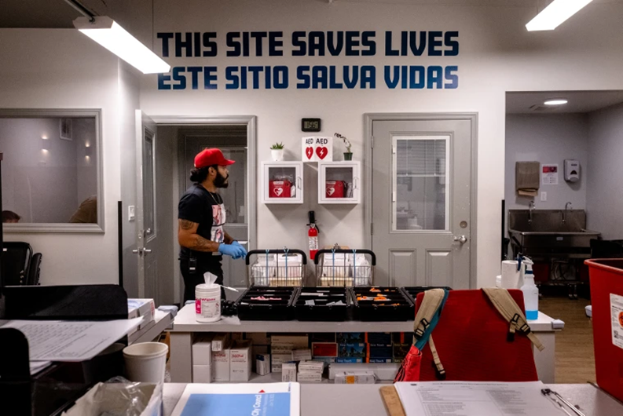
Discussion and Lessons Learned
Patient experience= expert advice
Limitations of sampling strategy
  Acute care encounters in ED
Recruitment at community-based settings and ambulatory clinics
Hard but important work!
OnPoint NYC, a harm reduction agency
Notes:
What we can really take away from this research is the variability of why patients receive emergency care after a stimulant overdose and in what they want and need from such a hospitalization. We know that patients are the experts of their own experiences, and it will be crucial to understand these experiences so that healthcare workers can best respond to them.
We ended up ceasing recruitment after encountering the limits of our recruitment strategy and scope of our project. We specifically focused on acute care encounters in the ED because we thought that this is where people would interface with the health system after a stimulant overdose. If these patients are sick enough to require a hospitalization, they may be sicker than the general population, and may not want to or have the capacity to sit down for an interview.
Community settinsg like harm reduction agencies or ambulatory care settings may yield individuals with histories of stimulant OD who have the necessary resources to participate in qualitative work.
This is hard work—we're having hard conversations with people having a hard time. However, it's deeply important work that can absolutely be built upon, especially given what our preliminary findings suggest in terms of improving ED outcomes.

Slide 15
Thank you!
This project was funded by CFAR Catalytic Pilot Grant #3A7479 (PI: Masyukova)

