Slide 1




Integrating Grief and Loss Conversations into the SBIRT Model
Produced in Partnership:
Notes:
Hello, welcome to today’s webinar – “Integrating Grief and Loss Conversations into the SBIRT Model”

Slide 2



Webinar Moderator
Tracy McPherson, PhD
Senior Research Scientist
Public Health Department
NORC at the University of Chicago
4350 East West Highway 8th Floor, Bethesda, MD 20814
McPherson-Tracy@norc.org
Notes:
I am Tracy McPherson and I will be the moderator for today’s event.

Slide 3



Produced in Partnership…
attcnetwork.org
amersa.org
sbirt.webs.com
Notes:
This webinar is produced in partnership with the ATTC Network Coordinating Office, AMERSA, and the Adolescent SBIRT Project by NORC at the University of Chicago.

Slide 4
The Impact of Substance Use on the Developing Adolescent Brain
Who's Doing What?: The Epidemiology of Adolescent Substance Use
Substance Use Interventions for Adolescents and Transitional Age Youth
Integrating Grief and Loss Conversations into the SBIRT Model
attcnetwork.org/centers/global-attc/tay-webinar-series
Notes:
This webinar is a part of the Transitional Age Youth Webinar Series. I encourage you to sign up for these other titles:
The Impact of Substance Use on the Developing Adolescent Brain
Who's Doing What?: The Epidemiology of Adolescent Substance Use
Substance Use Interventions for Adolescents and Transitional Age Youth
Integrating Grief and Loss Conversations into the SBIRT Model

Slide 5
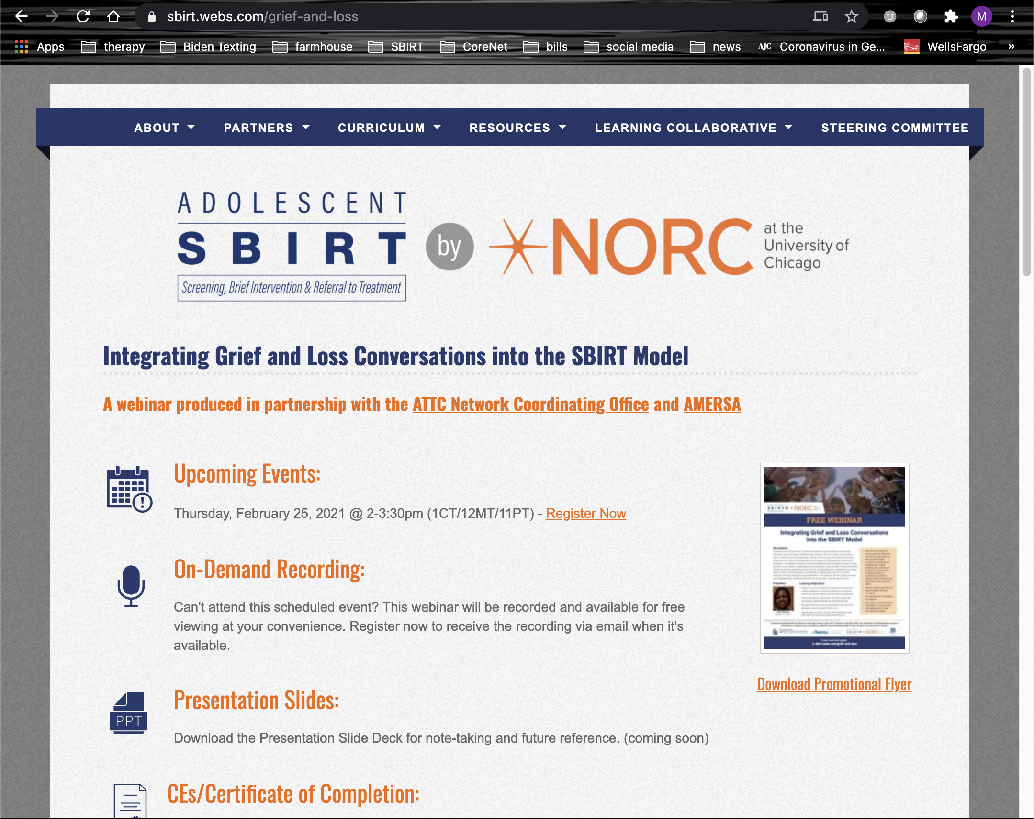
Access Materials
Bookmark the website
Follow-up email
On-demand access 24/7
Brief survey
Certificate of Completion brief application (1.5 NAADAC CE)
sbirt.webs.com/grief-and-loss
Notes:
You can access everything for this webinar at the website on your screen – now and in the future. That URL is sbirt.webs.com/adolescent-interventions
Our team will also send you a follow-up email later today that includes links to the PowerPoint slides, on-demand recording, brief survey, and instructions to claim your free CE Certificate. This webinar is approved for 1.5 CEs through NAADAC.

Slide 6
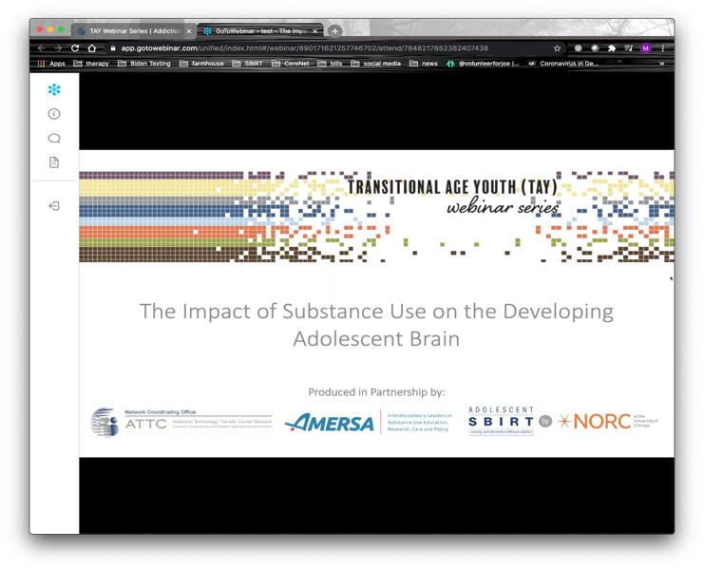
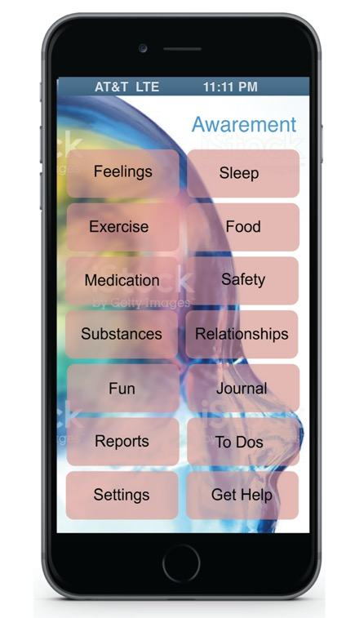
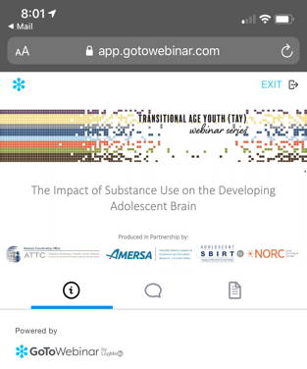
Access PowerPoint Slides
Access the PowerPoint slides through the “Handouts” pane of your GoToWebinar Control Panel on your computer or mobile device.
Or, download them from the website.
Notes:
You can access the PowerPoint slides through the “Handouts” pane of your GoToWebinar Control Panel on your computer or mobile device. Or, download them from the website.

Slide 7

Ask Questions
Ask questions at any point through the “Chat” pane of your GoToWebinar Control Panel on your computer or mobile device.
Answers will be posted on the website.
Notes:
You can ask questions at any point in this presentation through the “Chat” pane of your GoToWebinar Control Panel on your computer or mobile device.
Answers will be posted on the website.

Slide 8

Webinar Presenter
Lisa R. Connors, LCPC, NCC
Pastor, Counselor, and Professor
Notes:
Lisa Connors is the Associate Pastor of In His Image International Ministry, Inc. She is a Licensed Bachelor Social Worker, Licensed Clinical Professional Counselor, National Certified Counselor, Board-Certified Coach, Master Addiction Counselor, Certified Clinical Trauma Professional. Ms. Connors is a Certified Grief Counseling Specialist. She is also Certified in Thanatology [the study of death, dying, and bereavement]. She has been in the human services/social work/counseling fields for 30 years. She has worked in a variety of settings providing services to the despondent and downtrodden. Ms. Connors works tirelessly to help others reach their fullest potential in life, helping and empowering others who have been oppressed, stigmatized, marginalized, and victimized. Her greatest passion is working with individuals affected by HIV/ AIDS, substance use and mental health disorders, violence/ abuse/trauma, grief and loss, and social injustices. Ms. Connors earned her Bachelor of Social Work, Master of Divinity, Master of Arts in Professional Counseling degrees, respectively, and is completing her PhD in Psychology.

Slide 9
Educational Learning Objectives
As a result of participating in this webinar, you will be able to:
Define the various components of grief and loss and how it affects adolescents and young adults from a physical, emotional, cognitive, behavioral, and spiritual perspective.
Explore ambiguous, stigmatized, traumatic losses, and anticipatory, disenfranchised, and complicated grief.
Recognize the importance of screening for loss with their adolescent and young adult clients.
Identify ways to screen, conduct brief interventions, and refer high-risk individuals to appropriate services.

Slide 10

Opening Reading
GRIEF ONE DAY at a TIME: 365 meditations to help you heal after loss
By Dr. Alan Wolfelt

Slide 11

Ask yourself….
What stands in an adolescent’s way of grieving?
What makes it so hard for them?
Why does it seem to be “unnatural” for them to grieve their losses?
What contributes them putting their emotions on hold?
Who says they have to be strong?
When can they release their vulnerabilities?

Slide 12

Grief IQ: True or False?
Anger is not a normal response to loss.

Slide 13

Grief IQ: True or False?
Crying can help with resolving grief.

Slide 14

Grief IQ: True or False?
Each adolescent and young adult grieve differently.

Slide 15
Grief IQ: True or False?
All losses are the same.

Slide 16
Grief: What is it?
Grief is…
“deep or intense sorrow or distress, especially at the loss or death of someone or something. It is something that causes keen distress or suffering as a response to a loss.”

Slide 17

Grief: A Reaction to Loss
Grief is a continuing process with many changes.
Grief is a normal and natural reaction.
Grief is individualized and unique to the person experiencing it.
Grief is a reaction to the experience of many kinds of losses, not just death alone.

Slide 18

The Nature of Grief
Grief is different for everyone.
Support systems will vary.
Resources are not always known or available.
Everyone has different coping styles.
There are gender differences related to grief.
Grief reflects cultural and religious differences.
Individuals may be experiencing multiple losses.
The grieving journey depends on what else is going on in a person’s life.

Slide 19
Definition of Loss
Loss is the absence of a possession or a future possession of something that is deemed meaningful; absence of a relationship

Slide 20
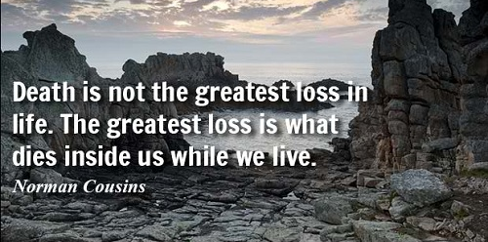
Death Loss is…
Grieving the loss of loved one, family member, pet as a result of death.

Slide 21
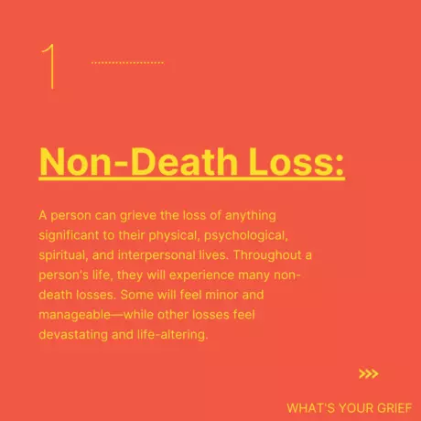
Non-Death Loss is…
Grieving the loss of anything significant to a person’s physical, psychological, spiritual, and interpersonal lives. Throughout a person’s life, they will experience many non-death losses.
Retrieved from https://whatsyourgrief.com/types-of-grief-2/

Slide 22

Reflective Activity
Think about losses adolescents and young adults have experienced and/or may be experiencing now?

Slide 23
Various Losses
Loss of a girlfriend or boyfriend
Loss of spouse through death or divorce
Loss of a parent or child through death or divorce
Loss of a family member or friend through moving, relocation, death
Loss of a child through miscarriage, stillbirth, adoption, abortion
Loss of motherhood or fatherhood/fertility
Loss of a beloved pet
Loss of relationships or friends
Loss of virginity

Slide 24
Various Losses
Loss of functioning through disability
Loss of sense of identity
Loss of sense of security
Loss of childhood through abuse or neglect
Loss of a job or financial stability/loss of money
Loss of health due to illnesses or diseases
Loss of a home or material possessions
Loss of a parent through degeneration of the brain, Alzheimer’s, or Dementia
Loss of parents due to college transition

Slide 25
Various Losses
Loss of parent through absence or emotionally unavailable
Loss of a future
Loss of independence
Loss of control
Loss of trust
Loss of new opportunities
Loss of milestones
Loss due to the military [deployment]
Loss of self-worth or self-esteem

Slide 26
Various Losses
Loss of a dream
Loss of native homeland
Loss of sobriety
Loss of safety
Loss due to natural disasters
Loss due to incarceration
Loss due to immigration
Loss of connections
Loss of love or intimacy
Loss of faith and hope

Slide 27
Is it just loss or Ambiguous Losses?
Ambiguous loss is different from ordinary loss. There may not be any verification of death or no certainty that the person will come back or return to the way they used to be. It freezes the grief process, prevents closure, and interrupts functioning.

Slide 28
What are Traumatic Losses?
Traumatic losses are reactions after a death that was sudden and unexpected (e.g., through violence or an accident) or a death that was not anticipated as a result of an illness or disease.

Slide 29
What are Stigmatized Losses?
Stigmatized losses are a form of cultural standards that affect the experience of the bereavement process, including ways in which one behaves, thinks, and feels about the loss.

Slide 30

Think about it!
What are some examples of stigmatized losses, and what reasons are these losses stigmatized?

Slide 31
Anticipatory Grief
Anticipatory is experienced before the loss. It occurs when individuals are expecting something to happen that they know will hurt them. It is the awareness that individuals know an impending loss is going to happen.

Slide 32
Disenfranchised Grief
Disenfranchised is a loss that cannot be openly acknowledged, socially validated, or publicly mourned. Disenfranchised grief often include grief that is encountered when a loss is experienced and can not be openly acknowledged or publicly shared.

Slide 33
Uncomplicated vs Complicated
Uncomplicated
Complicated
Uncomplicated is often called “normal”. It may include physical, emotional, cognitive, behavioral, and spiritual responses to loss.
…an ongoing, heightened state of mourning that keeps an individual from healing. In complicated grief, feelings of loss are debilitating and do not improve even after time passes. Individuals can become stuck in their pain.

Slide 34
Complicated Loss
Complicated grief is
chronic
delayed
exaggerated
masked

Slide 35
Signs and Symptoms of Complicated Loss
Intense sorrow and pain
Extreme focus on reminders of the loved one
Problems accepting the death or loss
Numbness or detachment
Bitterness about your loss
Feeling that life holds no meaning or purpose
Lack of trust in others
Inability to enjoy life or think back on positive experiences

Slide 36
Complicated Grief continues when…
Isolates from others and withdraws from social activities
Is “stuck”, and struggles to break free from traumatic circumstances
Experiences of depression, deep sadness, guilt, or self-blame occur
Feels life isn't worth living without their loved one

Slide 37
Risk Factors of Complicated Grief
Losing a loved one in a sudden or violent way
Social isolation or loss of a support system or friendships.
Individuals vulnerable to mood or anxiety disorders
Traumatic childhood experiences,
Other major life stressors
Culture or environment does not allow the grief process.

Slide 38

Reflective Activity
What are responses to loss?

Slide 39


Cognitive Responses to Loss
Confusion
Feeling in a fog
Racing thoughts
Preoccupation with loss
Forgetfulness
Wondering if anything really matters

Slide 40

Behavioral Responses to Loss
Hide feelings
Withdraw
Cry
Fight more with friends/ family
Improvement or drop in grades
Sleep or eat more or less frequently
Act differently: act out, reckless, risky behaviors
Use drugs/drinking to escape

Slide 41





Emotional Responses to Loss
Sadness, deep sorrow
Shock, Stunned
Anger,
Irritability
Frustration
Longing, loneliness, alienation
Anxiety, insecurity

Slide 42
Emotional Responses to Loss
Fear (of death, of others dying)
Guilt
Regret
Hope
Relief
Powerlessness, helplessness
Shame (at being different from peers)

Slide 43

Physical Responses to Loss
Headaches
Stomachaches
Tiredness
Sweat
Restlessness
Nightmares
Appetite changes

Slide 44

Spiritual Responses to Loss
Loss of faith in God
Confusion about God
Questioning God about the death/not understanding “why”
Angry with God about the death
Abandoning religious practices
Not attending worship services
Lack of hope/inability to forgive

Slide 45
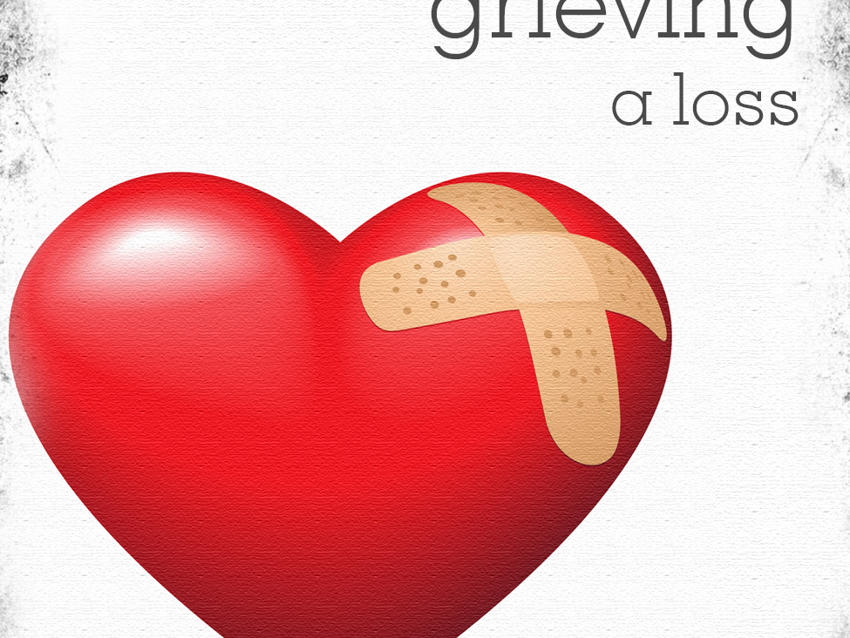
Inspirational Reading
Let grief find the freedom to be expressed. Let grief find the right to be understood.
~ Kei Gilbert

Slide 46
Brainstorm Activity
What do individuals when others are experiencing grief and loss?

Slide 47

Common Things individuals When Others are Grieving
“ It was God’s will”
“They’re better off now”
“At least they’re not in anymore pain”
“There must be a reason”
“You will be ok”
“The Lord giveth & the Lord taketh”
“ I understand/I know how you feel”
“This is what happens when you live that type of lifestyle”
“You must or should move on”

Slide 48

Common Things individuals When Others are Grieving
“It is just school.”
“Just call your friends another way.”
“It can’t be that bad.”
“You will get over it in time”
“It will be alright---you will get through it”
“Snap out of it”
“You got to be strong/Be strong for your family”
“You have gotten through other things; you can get through this”
“You are the strong one”
“You are still talking about that…”

Slide 49

What can you say or do?
“I am sorry for your loss”
“I can’t imagine what you are going through”
“I care”
“I don’t know why”
“I don’t know what to say, but I’ll be glad to listen”
“What can I do to help?”
OR
Give a hug or kiss
Hold the person’s hand
Be silent
Listen

Slide 50
The two most difficult emotions are...
Guilt
Regret

Slide 51

Brainstorm Activity: Some thoughts about how we can help, if grief is so stigmatized

Slide 52
NO MORE STIGMA!
Normalize grief and loss.
Do not judge or condemn others when they are grieving, no matter the loss.
Discuss grief and loss; do not change the subject.
Validate feelings.
Let grief be what it is, it is not a mental illness.
Do not rush or avoid the process of grieving.
Do not assume that individuals should think, feel, or act a certain way when grieving.
Embrace grief as a common experience.

Slide 53

Some principles of grief
Grieving is the natural reaction to a death or loss.
Each grieving experience is unique.
There are no “right” and “wrong” ways to grieve.
Every death or every loss is unique and is experienced differently.
The grieving process is influenced by many issues.
Grief is ongoing.

Slide 54
When an adolescent or young adult are not coping, you might see…
shock and disbelief
sadness
difficulty concentrating or remembering things
reluctance to go to school or work
disruptive behaviors/frequent fighting
non-compliance to requests
hyperactivity
increased need for attention
issues of abandonment, insecurity and safety concerns
fear, guilt, relief, anger, rage, regret, confusion

Slide 55
Risks Factors in Adolescents and Young Adults
Hopelessness, depression, intense sadness
Dramatic changes in personality
Antisocial or violent behaviors
Excessive guilt or self-blame related to the death or loss
Increased risk-taking or behaving dangerously
Inappropriate sexual behavior

Slide 56
Some Tips on Adolescents
Death and loss are viewed as unfair
Bodily changes magnify grief
May need permission to grieve
Feels concerned about being “different” from peers
Testing own mortality
May reflect on and/or glorify death

Slide 57
Some Tips on Young Adults
Grief comes with a huge range of emotions
Grief turns out to be so much more than just emotions
It’s hard to do things you used to be able to do
There’s no syllabus, how-to manual, or timeline for grief

Slide 58
Helping adolescents and young adults navigate their grief experience
Listen and talk with them
Provide safety and security
Provide opportunities for expression
Allow for a range of responses to loss

Slide 59
Using SBIRT in Grief and Loss Conversations
Screening
Brief intervention
Referral to Treatment

Slide 60
The Benefits of SBIRT are…
Preventing
Helping those with complicated grief symptoms become educated and get treatment.
Enabling the counselor [clinician] to screen
                DHHS, Centers for Medicare and Medicaid Services, 2014

Slide 61
Various Settings for Grief and Loss Conversations
Addiction Treatment Centers [Inpatient/Outpatient]
Correctional Facilities/Detentions Centers
OMHC/Therapist office
Rape Crisis & Domestic Violence Centers
Colleges/Universities
Hospital/ER
Hospice Organizations
Community Based/Faith Based Organizations/Faith Communities [Churches, Synagogues, Mosques, etc.].
Local Schools
Local Health Departments

Slide 62
Benefits of various settings…
Screen
Provide interventions
Provide education
Allow for simple triaging
Help clients recognize signs and symptoms for complicated grief
Brief interventions

Slide 63
Brief Interventions in Opportunistic Settings
Brief interventions are advantageous because:
Individuals are usually more open and accepting of this type of intervention
They allow for “teachable moments”
They can be useful in motivating clients with more severe issues to seek additional help
They are less expensive
They can be administered by variety of providers in a wider range of clinical settings

Slide 64
When having grief and loss conversations…
Listen with empathy
Provide regular opportunities to talk or check in with the adolescent or young adult
Don’t interrupt
Keep it open
Acknowledge the feelings you are hearing
Talk with them about more than just the loss

Slide 65
When Conducting a Grief and Loss Screening & Doing a BI
Ensure confidentiality.
Ask direct questions about specific responses to loss.
Normalize questions.
Be non-judgmental.
Start with less threatening questions.
Do not assume anything.
Ask for explanation of coping mechanisms.
Use specific terms.

Slide 66
What can you do in a Screening?
If you have one question to ask:
What loss or losses have been most impactful for you?
If you have two questions to ask:
Have you been anxious and depressed this week, last week, past month, 6 months, past year?
If yes, how many times?
Other questions: What was your loss? What have been some past losses? How have you coped? What else would you like to share?

Slide 67
Screening for Grief and Loss Using Brief Grief Questionnaire
The Brief Grief Questionnaire developed by M. Katherine Shear MD and Susan Essock PhD. It is an efficient tool to screen for complicated grief in health care settings.
To help screen for complicated grief…
Ask the five questions in the Brief Grief Questionnaire during a client’s/patient’s appointment.
Use with adults bereaved for at least 12 months and children at least 6 months.
Screen all bereaved individuals who seek treatment for suicide risk, mood, and anxiety disorders as well. These conditions may require treatment earlier than 6-12 months post bereavement.

Slide 68
Screening for Grief and Loss: Brief Grief Questionnaire (BGQ)
The Brief Grief Questionnaire is a 5-item screening tool which can be used to
identify individuals at high risk of complicated grief. Each question is numerically
scored with 0 (“not at all”), 1 (“somewhat”), or 2 (“a lot”). Individuals with scores
greater than or equal to 5 may benefit from referral to a trained mental health
provider. The questions are:
How much of the time are you having trouble accepting the death of a
loved one?
How much does your grief interfere with your life?
How much are you having images or thoughts of your loved one when
he or she died or other thoughts about the death that really bother
you?
Are there things that you used to do when your loved one was alive
that you don’t feel comfortable doing more, that you avoid? How much
are you avoiding these things?
How much are you feeling cut off or distant from other individuals since
your loved one died, even individuals you used to be close to, like family or
friends?

Slide 69
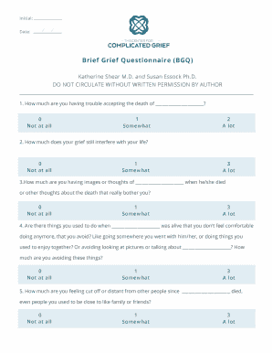
Brief Grief Questionnaire (Shear & Essock)

Slide 70
Screening for Grief and Loss: CAGE
C= Have you ever CUT people off while grieving your loss?
A = Have people ANNOYED or criticized you for grieving your loss?
G= Have you ever felt bad or GUILTY about grieving your loss?
E = Have you ever needed substances or engaged in risky behaviors as an EYE-OPENER to steady your nerves, to alleviate anxiety or depression, or to get rid of feelings associated with your loss?

Slide 71
Scoring for CAGE
Scoring: Item responses on the CAGE questions are scored 0 for "no" and 1 for "yes" answers, with a higher score being an indication of complicated grief A total score of two or greater is considered clinically significant. *NOTE: The normal cutoff for the CAGE is two positive answers, however, the Consensus Panel recommends that the primary care clinicians lower the threshold to one positive answer to cast a wider net and identify more clients or patients who may have complicated grief.

Slide 72
For further assessments, you can use..
Beck’s Depression Inventory. Retrieved from Beck's Depression Inventory (ismanet.org)
Complicated Grief Assessment. Retrieved from Supporting Resources - MHPN Working Together to Recognise and Treat Complicated Grief.pdf
Grief/Depression Assessment Inventory. Retrieved from grief_depression_inventory.pdf (integraonline.org)
Inventory of Complicated Grief. Retrieved from Inventory of Complicated Grief – (cornell.edu)
Public Health Questionnaire (PH-9). Retrieved from Depression 03 Update (umich.edu)
The Burns and Depression Anxiety Checklist. Retrieved from Burns-Checklists.pdf (fspcares.org)

Slide 73
What is important about Brief Interventions?
Meeting the client where they are at to:
  Deliver the most effective service
  Save time
  Dedicate limited financial resources

Slide 74
Brief Interventions/Brief Motivational Interventions
Sessions last 10-15 minutes and have four main elements:
  Establish rapport
  Raise the topic
  Provide feedback
  Enhance motivation

Slide 75

Conducting a Brief Intervention…
Understand the client’s views of loss and what they feel about the loss in their life
Give information/feedback
Negotiate a plan
Close

Slide 76

Brief Negotiated Interview…
Engagement
Pros & Cons
Feedback
Readiness Ruler
Negotiate Action Plan
Summarize and Thank

Slide 77
Enhance Motivation to Change
  Use readiness and confidence scale:
  Readiness scale = “On a scale of 0-10, how ready are you to get counseling or move towards the future? A 10 would mean you are fully ready to change and a 0 means you are not at all ready.” . If clients score a low number, then ask “What would need to happen for you to be at a higher number?”
  Confidence Scale = “On a scale of 0-10, how confident do you feel to make changes in your life after your loss? .” “A 10 would mean total confidence and a 0 means no confidence at all.” If clients score a low number on the confidence scale, then ask “What needs to happen for you to feel confident?” Allow clients to discuss.
                MA SBIRT, 2012

Slide 78

Using Motivational Interviewing
Motivational Interviewing encourage clients to talk, explore ambivalence about their grief and losses, and to clarify their reasons for taking this moving forward and taking this journey.
To apply motivational interviewing tools, apply the acronym OARS:
    Open questions
    Affirmations
    Reflective listening
    Summarize

Slide 79

Elicit-Provide-Elicit
In motivational interviewing , you could elicit-provide-elicit:
    Elicit what the client knows
    Provide new information
    Elicit the client’s response

Slide 80
Brief Intervention Questions
Name three individuals who have supported you thus far. How have they helped you? How will you continue to utilize them for support?
When you hear the expression, “accept your loss,” what comes to mind?
What makes it difficult for you to accept the loss?
What protective factors do you have to help you with your loss?

Slide 81
Brief Intervention may include
Capitalizing on a strengths-based approach:
  Is working together to find past and present successes and use these to address the challenges being faced
  Clinicians should be interested in clients’ strengths vs. weaknesses.
  Clinicians should be interested in helping clients build the best things in life vs. repairing the worst
  Clinicians should be interested in helping clients make their lives fulfilling vs. focusing on pathology.

Slide 82
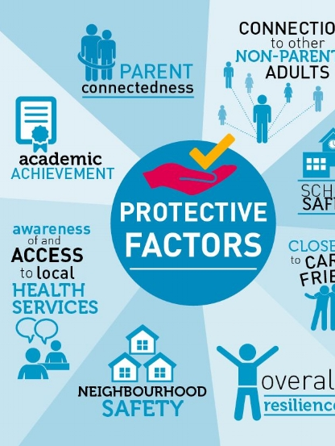
Brief Intervention may include

Slide 83
Brief Intervention may include exploring Protective Factors…
Social Support
Coping Skills
Physical Health
Sense of Purpose
Self-Esteem
Healthy Thinking/Mental Health
Spirituality/Beliefs
*Rank based on Weak, Moderate, Strong*
Retrieved from TherapistAid.Com

Slide 84
Using FRAMES
To identify key ingredients of brief intervention, Miller and Sanchez (1993) proposed six elements summarized by the acronym FRAMES:
  feedback
  responsibility
  advice
  menu of strategies
  empathy
  self-efficacy

Slide 85
Using FLO
A brief three‐step intervention known as “FLO,” which condenses the main elements of longer brief interventions into three easy steps

Slide 86


Using a Coaching Model: GROW

Slide 87
Using a Coaching Model: GROW
The GROW Model, for coaching, was developed in the 1980s by Sir John Whitmore and his colleagues at Performance Consultants International.
GROW is an acronym that is laid out as follows:
G – Goal
R – Reality
O– Options
W – Way Forward (What, When, by Whom and the WILL to do it)

Slide 88
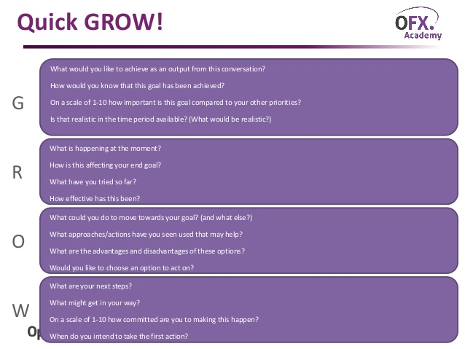

Slide 89
Referral to Treatment
Having a list of resources are essential for referrals and linkages to services and treatment
Knowing the different treatment methods of care are important (i.e. counseling, therapy, coaching.
Locator resources:
Psychology Today: Psychology Today: Health, Help, Happiness + Find a Therapist

Slide 90
SBIRT: Key Points
Before using SBIRT, please consider:
What screening and assessment tools will be used?
Will the same person perform the screening, brief intervention, and referrals?
How will staff be continuously trained and informed about SBIRT?
Which clients might be excluded from screening?
How often will clients be screened?
Will educational materials be distributed to clients? If so, which ones?
Where/how will client needing further assessment or referral be referred? What referrals are currently used?
How will SBIRT results be documented? Will it be entered into EMR?
Who will assure that SBIRT procedures occur regularly?
Can SBIRT generate revenue?
                MA SBIRT, 2012

Slide 91
Helping a Grieving Adolescent and Young Adult
Understand their loss in new ways at each developmental milestone or life transition.
Adolescents and young adults are more likely to talk with their friends about their grief than with their parents and caregivers.
Adolescents and young adults yearn to discover the significance or reason behind the loss and what it means for them and their lives.
Don’t assume that an adolescent and young adult aren’t grieving.

Slide 92
Key Points when providing support…
Provide
Provide gentle, consistent support, even if they say “no”
Be
Be available, but don’t push them to talk
Help
Help them find peers who are supportive
Find
Find other trusted adults they can talk with, such as a counselor, spiritual leader, or mentor
Assist in
Assist in relieving burden of adult responsibilities

Slide 93
Best Practices in the Field
Help the client or patient acknowledge past accomplishments as a way of re-establishing self-esteem.
Affirm his/her ability to survive the current loss.
Help him/her identify feelings of loss and feel pain.
Give him/her permission to cry—and permission to feel relieved if he/she does experience relief.

Slide 94
This is what I need you to know…
Don’t force me to talk … there may be times that I’d rather be quiet.
Check in with me sometimes. Even though I’m venturing out on my own, I still need adults and a parent around to guide me.
Instead of saying “I know how you feel,” ask “What is that like for you?” or “What are you feeling?”
Listen to me and what my grief is like. We’re all different in our grief, and I may be grieving differently from the way you do.. Listening to me shows you respect me.
• Don’t tell me to “be strong.” I’m learning that it’s OK to feel and show vulnerable emotions, and it helps when you remind me of that, too.

Slide 95
Teen’s Bill of Rights by adolescents and young adults at the Dougy Center
A grieving teen has the right….
...to know the truth about the death, the deceased, and the circumstances.
...to have questions answered honestly.
...to be heard with dignity and respect.
...to be silent and not tell you her/his grief emotions and thoughts.
...to not agree with your perceptions and conclusions.
...to see the person who died and the place of the death.
...to grieve anyway she/he wants without hurting self or others.
...to feel all the feelings and to think all the thoughts of his/her own unique grief.
...to not have to follow the “Stages of Grief” as outlined in a high school health book.
...to grieve in one’s own unique, individual way without censorship.
...to be angry at death, at the person who died, at God, at self, and at others.
...to have his/her own theological and philosophical beliefs about life and death.
...to be involved in the decisions about the rituals related to the death.
...to not be taken advantage of in this vulnerable mourning condition and circumstances.
...to have guilt about how he/she could have intervened to stop the death.
*This Bill of Rights was developed by participating adolescents and young adults at The Dougy Center and does not represent “official” policies of the Center.

Slide 96
Closing Reading…
OK?
~ Bea Mitchell

Slide 97
Remember…
“Grief is a normal and necessary process that is fundamentally a journey of the heart and soul”
~Dr. Alan D. Wolfelt

Slide 98
References
Australian Centre for Grief and Bereavement (2015). Adolescents and grief. Retrieved from Adolescents-and-Grief.pdf (kinstacdn.com)
Boss, P. (2018). Four questions about ambiguous loss. Retrieved from http://www.ambiguousloss.com/four_questions.php
Center for Life and Loss Transition (2016). Helping teenagers cope with grief. Retrieved from Helping Teenagers Cope with Grief - Center for Loss & Life Transition
Community Care of North Carolina [nod]. FRAMES and BNI.
Department of Health and Human Services (2014). Screening, brief intervention, and referral to treatment (SBIRT) services. Department of Health and Human Services, Centers for Medicare & Medicaid Services, Baltimore, MD. Retrieved from https://www.cms.gov/Outreach-and-Education/Medicare-Learning-Network-MLN/MLNProducts/downloads/SBIRT_Factsheet_ICN904084.pdf.
Doka, K. (2014). 6 ways that adolescent grief is different. Retrieved from 6 Ways That Adolescent Grief Is Different | HuffPost Life

Slide 99
References, continued
Dougy Center (2020). How to help a grieving teen. Retrieved from The Dougy Center for Grieving Children & Families | Portland, OR
Ducoat, L. J. (2018). The stigma of grief. Retrieved from https://blogs.psychcentral.com/grief/2017/06/the-stigma-of-grief/
Dunn, C. & Fields, C. (2007). SBI Training for Trauma Care Providers. Substance Abuse and Mental Health Services Administration, CSAT. Washington, DC: George Washington University.
Ewing J, A. (1984). Detecting alcoholism: The CAGE questionnaire. JAMA: Journal of the American Medical Association, 252:1905-1907. Retrieved from Instruments Catalog: Search Results (washington.edu)
FRAMES model [n.d.]. Retrieved from Brief Interventions : FRAMES Model | Methoide (arizona.edu)
Hitchens, J. (2017). Navigating grief: A coach for grief. Retrieved from http://www.navigatinggrief.com/about-coaching/.

Slide 100
References, continued
Houben, L. (2017). Transforming grief and loss workbook. Eau Claire, WI: PESI Publishing and Media.
Integrating Adolescent SBIRT Throughout Social Work & Nursing Education [n.d.]. Retrieved from https://sbirt.webs.com/
Luchterhand, C. (2019). Screening for complicated grief. Retrieved from Brief-Grief-Questionnaire-2018.pdf (va.gov)
Massachusetts Department of Public Health (2012). SBIRT Screening Toolkit. Boston, MA. Retrieved from http://www.masbirt.org/sites/www.masbirt.org/files/documents/toolkit.pdf.
Mayo Clinic (2017). Complicated grief. Retrieved from https://www.mayoclinic.org/diseases-conditions/complicated-grief/symptoms-causes/syc-20360374
McMahon, R. & Persson, K. L. (2008). Good Mourning: A resource for healing. Fall Church, VA: Capital Caring.

Slide 101
References, continued
Miller, K. (2020). What is the GROW coaching model? Retrieved form What is the GROW Coaching Model? (incl. Questions + Examples) (positivepsychology.com)
Miller, W. R. & Sanchez, V. C. (1993). Motivating young adults for treatment and lifestyle change. In: Howard, G., ed. Issues in Alcohol Use and Misuse in Young Adults. Notre Dame, IN: University of Notre Dame Press.
Modern loss (2017). Complicated grief: How it’s different. Retrieved from http://modernloss.com/complicated-grief-different/
Mortell, S. (2015). Assisting clients with disenfranchised grief: The role of a mental health nurse. Journal of Psychosocial Nursing and Mental Health Services, 53(4), 52-57.

Slide 102
References, continued
Pacific AIDS Education and Training Center (2014). Short and simple: Screening and brief intervention tips for HIV clinicians working with alcohol and drug users. Retrieved from Microsoft Word - Full Day SBIRT_Fact Sheet (aidsetc.org)
Palliative Care Network of Wisconsin (2021). Screening for complicated grief. Retrieved from Screening for Complicated Grief - Palliative Care Network of Wisconsin (mypcnow.org)
Pillai-Friedman, S., & Ashline, J. L. (2014). Women, breast cancer survivorship, sexual losses, and disenfranchised grief – a treatment model for clinicians. Sexual and Relationship Therapy, 29(4), 436-453.
Risk and protective factors [n.d.]. Retrieved from Risk & Protective Factors | Youth.gov
7 Stages of Grief: Through the process and back to life (2018). Retrieved from https://www.recover-from-grief.com/7-stages-of-grief.html
SBIRT Oregon (2015). Retrieved from http://www.sbirtoregon.org/training.php.

Slide 103
References, continued
Shear, K. & Essock, S. [n.d]. Brief grief questionnaire. Retrieved from BGQ.pdf (columbia.edu)
Spidell, S., Wallace, A., Carmack, C., Nogueras-Gonzalez, G.M., Parker, C., & Cantor, S. B. (2011). Grief in healthcare Chaplains: An investigation of the presence of disenfranchised grief. Journal of Health Care Chaplaincy, 17, 75-86.
St. Clair, J. S. (2013). The witnessing of disenfranchised grief: Reliability and validity. Journal of Nursing Measurement, 21(3), 401-414. doi: 10.1891/1061-3749.21.3.401
The Center for Complicated Grief (2017). Providing good support. Retrieved from https://complicatedgrief.columbia.edu/resources/resources-public/providing-good-support/

Slide 104
References, continued
The Dougy Center [n.d.]. Don’t be surprised when…Tips for young adults grieving a death. Retrieved from Tips_for_Young_Adults_Grieving_a_Death.pdf (dougy.org)
Transitions’ Grief Care (2020). Understanding adolescent and young adult grief and ways to provide support. Retrieved from Grief Care for Adults and Children - Transitions GriefCare (transitionslifecare.org)
Vitas Healthcare [n.d.]. Techniques used to assist the bereaved. Retrieved from Specific Questions, Techniques Can Help the Bereaved Cope with Loss | VITAS Healthcare
WebMD (2017). What is normal grieving, and what are the stages of grief? Retrieved from https://www.webmd.com/balance/normal-grieving-and-stages-of-grief#1.

Slide 105
References, continued
What is traumatic loss (2018)? Retrieved from http://www.teachtrauma.com/information-about-trauma/types-of-trauma/traumatic-loss/
What’s your grief (2018). 64 Myths About Grief That Just Need To STOP. Retrieved from https://whatsyourgrief.com/64-myths-about-grief-that-just-need-to-stop/
Wolfelt, A. D. (2006). Companioning the bereaved: A soulful guide for caregivers. Fort Collins, CO: Companion Press.
Worden, W. (2009). Grief counseling and grief therapy (4th ed.). New York, NY: Springer Publishing Company.

Slide 106
Thank You!
Lisa R. Connors, LCPC, NCC
Pastor, Counselor, and Professor

Slide 107
In Our Last Few Moments…
Follow-up email
PowerPoint slides
On-demand access 24/7
Brief survey
Certificate of Completion brief application (1.5 NAADAC CE)
sbirt.webs.com/grief-and-loss
Notes:
As a reminder, our team will send you a follow-up email later today that includes links to the PowerPoint slides, on-demand recording, brief survey, and instructions to claim your free CE Certificate. If you want to access any of these things now before the email arrives, you can do so at this webinar’s website: sbirt.webs.com/grief-and-loss

Slide 108

Related Products & Resources
from the ATTC Network
CLAS Standards in Behavioral Health: Working with Youth and Adolescents (Recorded webinar)
Understanding Latino Youth Recovery: Issues, Assets and Creating Resiliency (Recorded webinar)
Adolescent Brain Maturation and Health: Intersections on the Developmental Highway
  Recorded presentation
  Handouts
Effects on Marijuana Use on Developing Adolescents (Recorded webinar)
Vaping Overview and CATCH My Breath Program (Recorded webinar)
Vaping 2: Education vs Punishment Using Deferred Citation (Recorded webinar)
Understanding Suicide Part 2 Adolescents and the Changing Brain (Recorded webinar)
attcnetwork.org/centers/global-attc/tay-webinar-series
Notes:
To augment the information provided today, you can check out these additional resources from the ATTC Network.

Slide 109
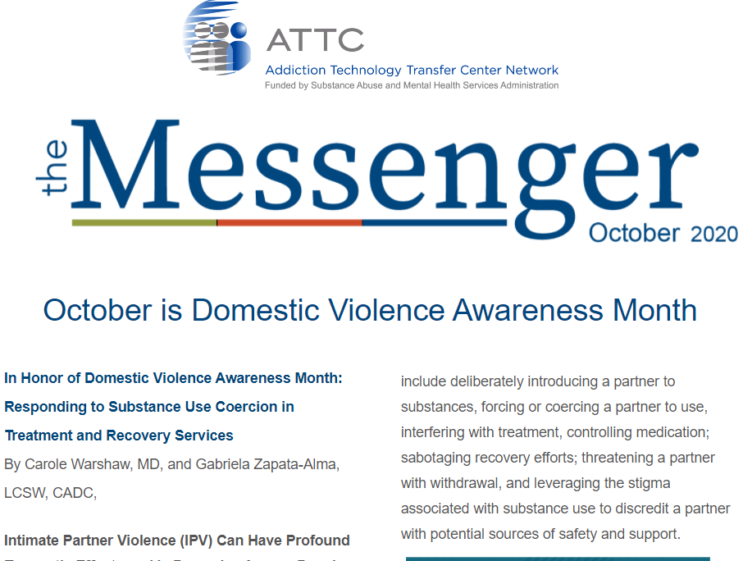


Keep in Touch with
the ATTC Network
ATTC Network Office publishes the Messenger monthly
  Subscribe: https://attcnetwork.org/centers/global-attc/subscribe-attc-messenger
@ATTCnetwork
@attcNetwork
attcnetwork.org/centers/global-attc/tay-webinar-series
Notes:
You can also keep in touch with the ATTC via their newsletter and social media. Sign up now for the Messenger monthly email and follow them on Twitter and Facebook.

Slide 110

Related Products & Resources
from the PTTC Network
Underage Alcohol Use: An Overview of Data and Strategies (Recorded webinar)
Youth Opioid Addiction: What Preventionists Need to Know (Recorded webinar)
Selecting and Implementing Evidence-Based Practices to Address Substance Misuse Among Young Adults: Webinar on SAMHSA’s Resource Guide
Preventing Youth Vaping (Webinar Series) Part 1 of 2: The Extent and Risk Factors for Youth Vaping (Recorded webinar)
Preventing Youth Vaping Part 2 of 2: Policy Recommendations and Promising Practices for Addressing Youth Vaping (Recorded webinar)
The Benefits of Engaging Youth in Communities: Insights and Evidence from Developmental Science (Recorded webinar)
Vaping and LGBTQ Youth (Recorded webinar)
Informing Prevention 6-Part Webinar Series on Adolescents: Mountain Plains PTTC
Adolescent SBIRT Pocket Card
attcnetwork.org/centers/global-attc/tay-webinar-series
Notes:
The PTTC network also has a plethora of resources available to support adolescents.

Slide 111
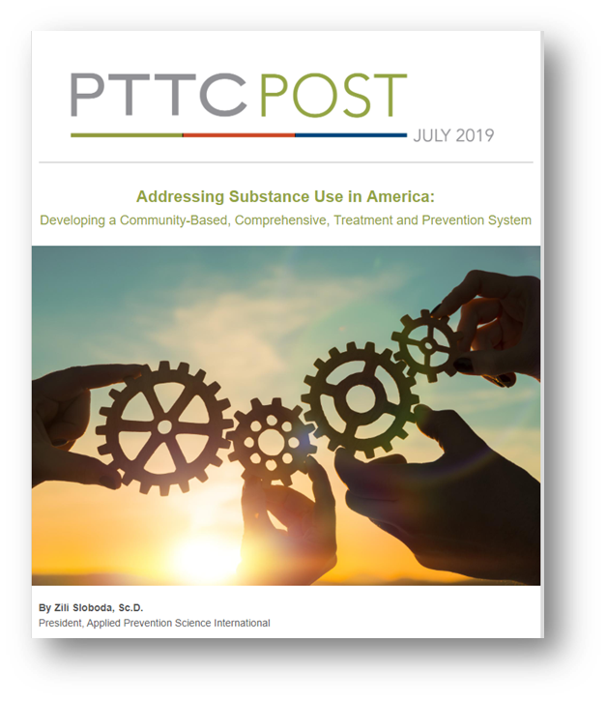
Keep In Touch with
the PTTC Network
PTTC Network Office publishes the PTTC POST monthly
  Please Subscribe:
  https://pttcnetwork.org/centers/global-pttc/pttc-subscription-page
@PTTCnetwork
@PreventionTTCnetwork
attcnetwork.org/centers/global-attc/tay-webinar-series
Notes:
As well as a monthly newsletter The PTTC Post and Twitter and Facebook accounts. These are great organizations to stay connected to.

Slide 112
Integrating Grief and Loss Conversations into the SBIRT Model
Produced in Partnership:
attcnetwork.org/centers/global-attc/tay-webinar-series
Notes:
And, with that, I thank you so much for attending and will now conclude today’s webinar. I hope you have a great rest of your day.

