Slide 1



Digital Mental Health and Addiction Interventions for Adolescents, Young Adults and Families
Produced in Partnership:
Notes:
Hello, welcome to today’s webinar – “Digital Mental Health and Addiction Interventions for Adolescent, Young Adults and Families”

Slide 2





Produced in Partnership…
attcnetwork.org
amersa.org
sbirt.webs.com
Notes:
This webinar is produced in partnership with the ATTC Network Coordinating Office, AMERSA, and the Adolescent SBIRT Project by NORC at the University of Chicago.

Slide 3

The Impact of Substance Use on the Developing Adolescent Brain
Who's Doing What? The Epidemiology of Adolescent Substance Use
Substance Use Interventions for Adolescents and Transitional Age Youth
Integrating Stigmatized Loss and Disenfranchised Grief into the SBIRT Model
amersa.org/resources/tay-webinar-series
Notes:
This webinar is a part of the Transitional Age Youth Webinar Series. I encourage you to sign up for these other titles at the AMERSA , ATTC or NORC websites.

Slide 4
Substance Use in Adolescents and Transitional Age Youth: Justice Involvement and Homelessness
Digital Mental Health and Addiction Interventions for Adolescents, Young Adults and Families
amersa.org/resources/tay-webinar-series

Slide 5

Webinar Presenter
Fred Muench, Ph.D. President,
Partnership to End Addiction
Notes:
Today’s webinar presenter is Fred Muench. Dr. Muench is a clinical psychologist and the President of The Partnership to End Addiction. His focus is on building and testing digital interventions to prevent problem substance use and treat addiction in real-world settings for young people and their concerned others. Fred has been the PI on multiple behavioral health grants from NIAAA, NIDA, FDA, RWJF Pioneer, Upswing, Twilio, and many others to improve behavioral health outcomes using technology. It is my pleasure to introduce Fred Muench.

Slide 6

Partnership to End Addiction
Partnership to End Addiction is a
national nonprofit that exists to:
  Empower families
  Advance effective care
  Shape public policy
  Change culture
We help the helpers
Notes:
So, who are we, at the Partnership to End Addiction?
We are a national nonprofit that exists to:
Empower families – We believe that families can be the key to preventing substance use and helping a loved one get healthy.
Advance effective care – Good, effective substance use prevention and treatment are based in science. We work to advance that science.
Shape public policy – Substance use – like other health conditions – is directly affected by the decisions of those in government. We work to have a positive impact on policymakers' choices.
Change culture – Unlike many other health conditions, stigma exists around substance use. We work to change culture to end stigma and remove obstacles to seeking support.
In short, we help the helpers & help families find answers

Slide 7
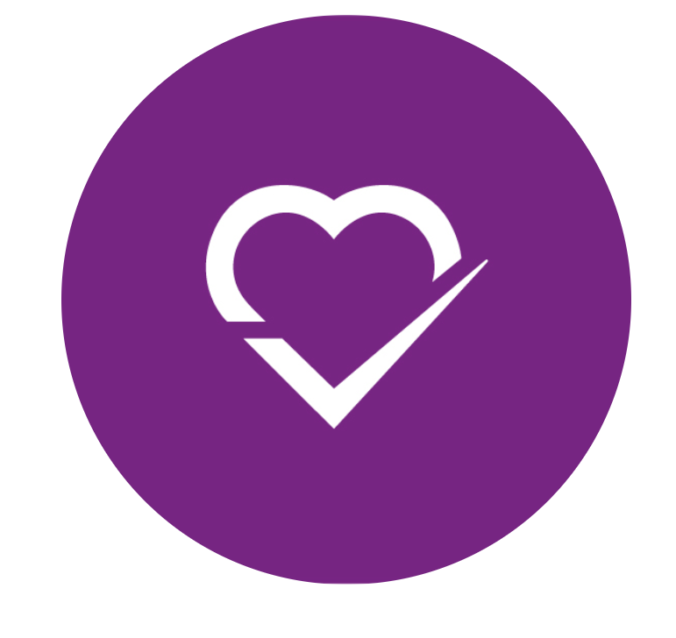
Presentation Acknowledgements
Patricia Aussem
Amit Baumel
Rachel Chernick
Kevin Collins
Creighton Drury
Deborah Estrin
Aaron Hogue
Alexis Kuerbis
Doug Leu
Jon Morgenstern
JP Pollack
Shankar Ramkellawan
Jack Sykstus
Partnership Staff (lots of people!)
*Funding Support from NIAAA, NIDA, AAAP, Upswing, Mother Cabrini, Twilio, & Google.
*No conflicts of interest related to addiction services. I have several patents on using passive stimulation to create cardiovascular resonance.

Slide 8
Presentation Objectives
Ingredients of successful digital interventions
The landscape of digital SUD interventions in general and for adolescents, young adults (AYA), and families
Research on digital technologies from prevention to recovery for AYA
Existing and low hanging fruit opportunities for practitioners and researchers

Slide 9
Technology is a Tool
The simplest form of technology is the development and use of basic tools.
The prehistoric discovery of how to control fire and the later Neolithic Revolution increased the available sources of food, and the invention of the wheel helped humans to travel in and control their environment.
Developments in historic times, including the printing press, the telephone, and the Internet, have lessened physical barriers to communication and allowed humans to interact freely on a global scale.
Tools can create new tools
https://en.wikipedia.org/wiki/Technology
Notes:
https://en.wikipedia.org/wiki/Technology

Slide 10
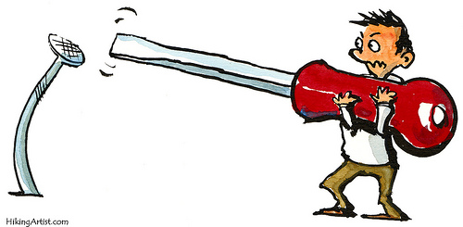
But we have to use it the right way
And be mindful of its power and downside

Slide 11
Barriers/Service Limitations
Intervention Target
Medium
Technology
Notes:
First barrier
Then – what do you want do
Then how can tech help
Then what is the best medium

Slide 12
Technology mediums / modes offer enhanced opportunities to connect and intervene based on how people live
Episodic and continuous
Synchronous and asynchronous
Automated and human
Passive and active
Captured and ephemeral
*Effortless and Salient
Notes:
This is how we think about and define the continuum of substance use.
It's important to note that every family is different: Even within a family, different kids may be in different places
Early Childhood: Getting a healthy start
Non-Use: Not using substances
Non-Pattern Use: Experimentation
Pattern Use: Using substances on a regular basis
Problem Pattern Use: Habitual substance use despite bad things happening
Addiction: Risky use, often resulting in relationship problems, neglect of major roles and physical symptoms
Recovery: Not using substances or using without negative consequences
Regardless of where you and your child are on the continuum of substance use and addiction – from it not even being a concern at all to it dominating your every waking thought – we're here to help.

Slide 13
Technology Features & Applications
Feature | Applications
Voice & Text | SMS, IVR, push alerts, emotional tone, natural language processing, vocal prosody, repeated brief assessment, psycho-edu, information, peer and specialist support, virtual agents, therapy, etc.
Camera & Video | Telepsych, modeling, environmental monitoring, visual analysis, biomonitoring
Gyroscope & Activity Monitoring | Activity monitoring, behavioral activation, sleep monitoring, arm movement
Geolocation | Location, triggers, activity scheduling, etc.
Ambient Light, Sound, environmental Sensors | Improved understanding of environment (eg bar versus home, dark versus light)
Proximity Sensors | Other phones, social gathering, peer triggers
Add-ons & Wearables | Physiological monitoring, reaction and arousal, alcohol sensing, drug sensing, passive stimulation for guidance and intervention
Notes:
Activity Monitoring
Fitbit, Nike Plus, Body Media, etc.
Sleep
Zeo Personal Sleep Coach, Sleep Stream 2 Smart Alarm Clock, Sleep Cycle
HR, HRV, GSR devices.
GPS, Geolocation (Behavioral Activation)
MapMyTracks.com, endomondo, InstaMapper, CHESS
Passive sensing – using features embedded in the phone
BeWell
Bluetooth
Online video viewers will reach 169.3 million in 2012.
SMS: Proactive automated support for individuals, remote data download.
VOICE: Conversations among couples, dinner conversations, a child playing with friends or interacting with parents or any interpersonal communication. Need email encryption.
VIDEO/MMS
Phobic reactions and fear based stimuli, standard drinks, food intake, other modeling and self-modeling.
Associated App: Momento Journal writing app. It allows you to make entries using text or photos and allows you to tag them with people from your address book, and locations from the GPS as well as category tags.
Accessing the Capabilities Built into the SmartPhone
Aside from utilizing mobile phones, other capabilities of the phone can be used today. The multiple features of smart phones make them therapeutic gold. For example, individuals can record their feelings in vivo using the simple audio recordings or videos of themselves for later review with the therapist. These features can be especially useful for child, family, and couple’s therapists who need to capture real world situations, which are rarely replicated in the therapeutic environment. Clients can place their phone on the dinner table and send the recording to their therapist to review. Additionally, with new voice recognition built into newer phones, therapists can sit with a client’s mobile phone and verbally cue reminders through the week until the next session and remind them of the next appointment. The camera is already being used by the numerous health eating applications where one takes pictures of their food and gets it evaluated by a third party. An individual therapist can ask clients to take pictures of stressful environments or other stimuli that are relevant to treatment goals. These built-in features can also be used to enhance efficacy through feed-forward audio and video modeling where a person records themselves successfully completing a task to be replayed later or therapists can model appropriate behaviors for clients that can offer extra support in difficult situations through video playback.

Slide 14
Technology mediums / modes have evolved to offer new opportunities that build off one-another
TV
Reach/Dissemination/Scale
Standardization
CD ROM
Interactivity
Personalization/Tailoring
Adaptability
Web
Data capture/Analytics
Social interaction
Stigma reduction
Disclosure
Mobile Phone
Salience/Triggers
Effort
Just-in-time adaptability
Sensors
Precision
Objectivity (relative)

Slide 15
What is tech good – and less good at doing?
Good
Reach
Disclosure
Salience
Analytics-Predict
Personalization
Adaptation
Connectivity/Just-in-time
Concerns
Dehumanization
Reliance
Information Overload
Messy/unreliable data
Privacy
Security
Maintenance

Slide 16
Acceptability & Comfort
Youth use technology and like it
Youth prefer digital health connections for stigmatizing topics
There is no digital divide by race, ethnicity or SES in youth
The greatest digital divide is in older adults and lack applications in different languages
Notes:
The high level of acceptance and use of digital technology by AYAs, particularly on their mobile devices, facilitates the broad reach of digital platforms for preventive health at relatively low cost [5,[34], [35], [36], [37],[99], [100], [101], [102]]. Clinicians, for example, can reach large groups of AYAs by fielding anonymous health-related questions on digital platforms [46,103].

Slide 17

Reach / Connection
Cognitive Salience
Emotional Salience
Behavioral Salience
Environmental Salience
Social Salience
Object Salience
Notes:
The high level of acceptance and use of digital technology by AYAs, particularly on their mobile devices, facilitates the broad reach of digital platforms for preventive health at relatively low cost [5,[34], [35], [36], [37],[99], [100], [101], [102]]. Clinicians, for example, can reach large groups of AYAs by fielding anonymous health-related questions on digital platforms [46,103].

Slide 18
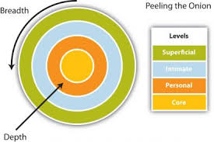
Disclosure
Youth and adults disclose significantly more to digital platforms than in person.
Digital mental health communication vs. in-person preferences moderated by condition (anxiety) and type of disclosure (stigmatizing)
Youth prefer to talk about sensitive topics over text but in-person for less stigmatizing topics.
Social Penetration Theory
Notes:
(Griest, 1973; Levine et al., 1989; Petrie & Abell, 1994; Lucas, 1977), Car, 1983; Locke et al., 1992; Skinner et al., 1983; Tourangeau & Smith, 1996; Turner, Ku, Rogers, Lindberg, & Pleck, 1998; Des Jarlais et al., 1999; Lapham et al., 1991).

Slide 19
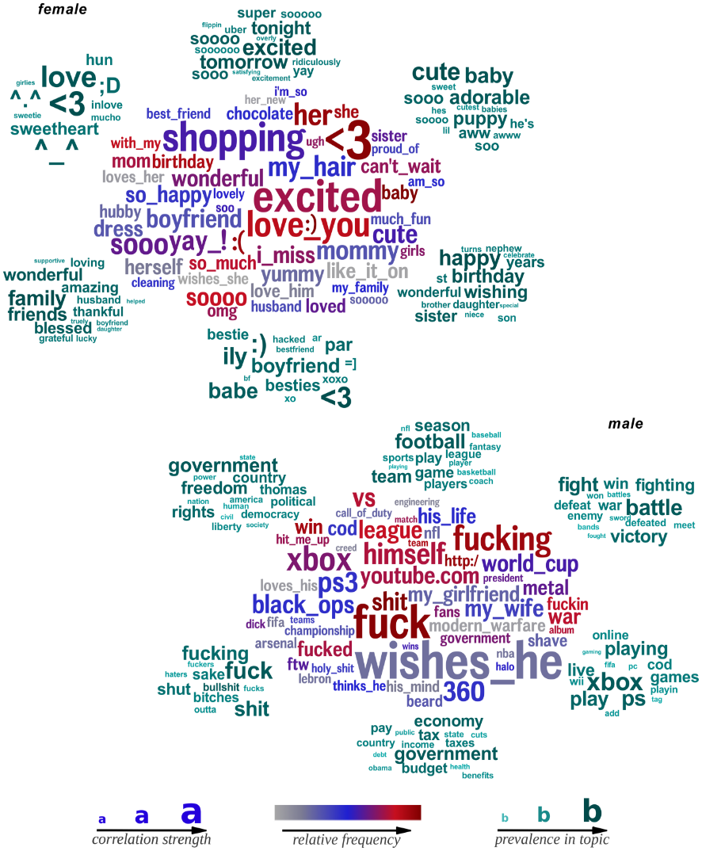
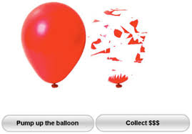


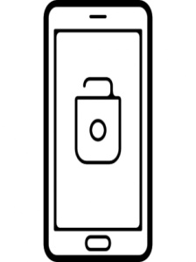

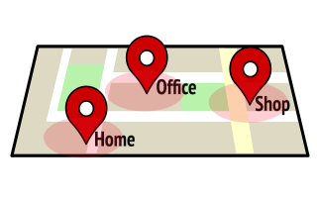
Passive & Active Data in the Real World
BART
survey
accelerometer
call log
screen status
geofence
Notes:
Assessment is the foundation – one thing that actually works
VOICE and Text
https://pubmed.ncbi.nlm.nih.gov/32936777/
https://www.researchgate.net/publication/335381925_Identifying_Suicidal_Adolescents_from_Mental_Health_Records_Using_Natural_Language_Processing
https://www.cambridge.org/core/journals/natural-language-engineering/article/natural-language-processing-in-mental-health-applications-using-nonclinical-texts/32645FFCFD37C67DA62CA06DB66EB2F4

Slide 20
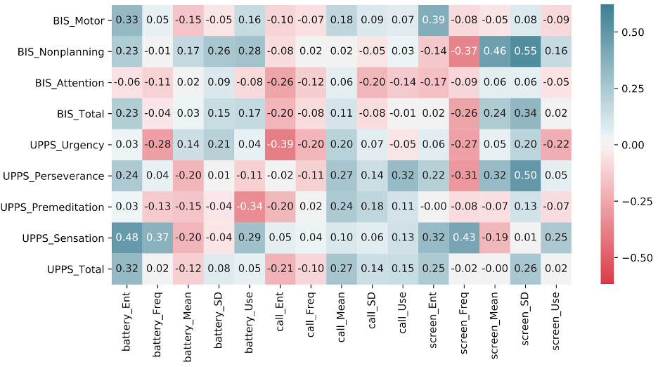
Passive & Active Data

Slide 21
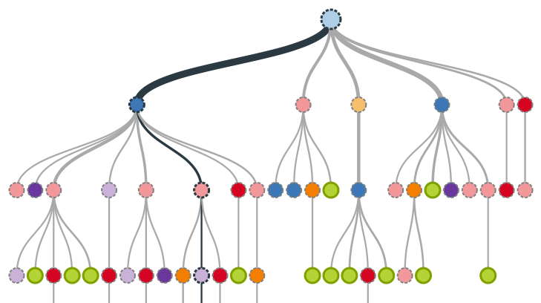
Personalization

Slide 22
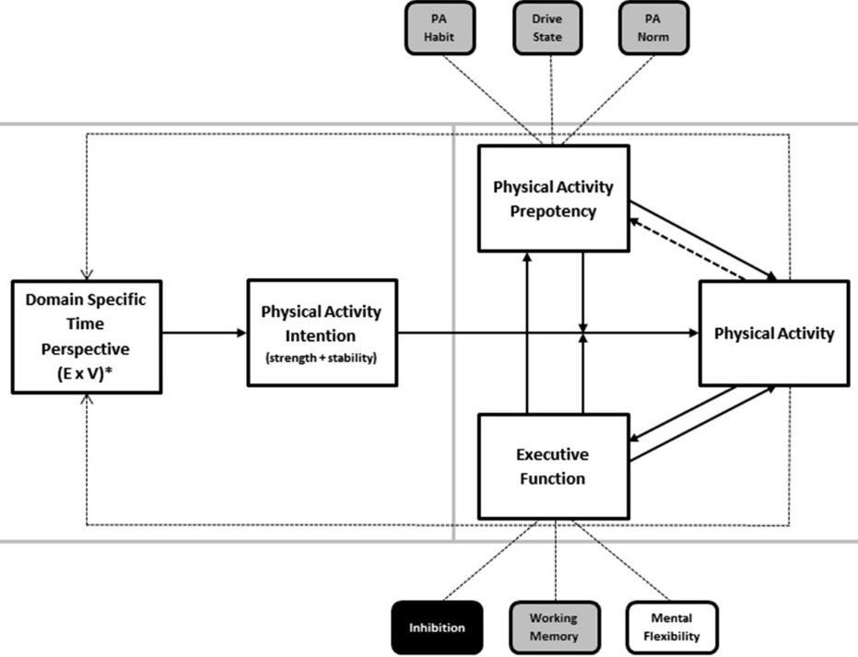
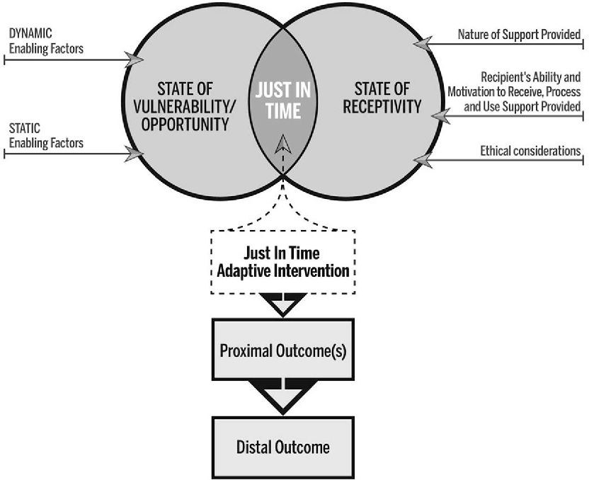
Mixed Just-in-Time Adaptive Models
Self-Regulation Theory
Nahum-Shani, Hekler, Spruijt-Metz, 2015
Notes:
Slef Regulation theory –
Not mutually exclusion

Slide 23
Message Timing and Drinking
Muench F., van Stolk-Cooke K, Kuerbis A, Stadler G, Baumel A, Shao S, et al. (2017). A Randomized Controlled Pilot Trial of Different Mobile Messaging Interventions for Problem Drinking Compared to Weekly Drink Tracking. PLoS ONE 12(2): e0167900. PMC5287456
Notes:
Exploratory examination of demographic characteristics (e.g. age, gender), and mobile phone use (e.g. SMS plan, where keep phone) revealed only one predictor

Slide 24




Ongoing Connection
Engage
Sustain
Micro interventions foster salience and timely support

Slide 25
Adolescent Developmental Needs
Peer connection
Independence
Exploration
Resilience/Confidence
Identity formation
Security
Notes:
Hoffman, B. R., Sussman, S., Unger, J. B., & Valente, T. W. (2006). Peer influences on adolescent cigarette smoking: a theoretical review of the literature. Substance use & misuse, 41(1), 103-155.
Chaiton, M. O., Cohen, J. E., O'Loughlin, J., & Rehm, J. (2009). A systematic review of longitudinal studies on the association between depression and smoking in adolescents. BMC public health, 9(1), 356.
Hanson, M. D., & Chen, E. (2007). Socioeconomic status and health behaviors in adolescence: a review of the literature. Journal of behavioral medicine, 30(3), 263-285.
Charlton, A., & Blair, V. (1989). Predicting the onset of smoking in boys and girls. Social science & medicine, 29(7), 813-818.

Slide 26

Predictors of Adolescent Substance Use
Expectancies and Motivations for Use
Availability
Access
Environment
Culture
Peers
Parents and Family
Alternate Activities
Mental Health / Resilience
Attitudes and beliefs
Personality
Temperament/Genetics
Social
Situational/Conformity
Experimentation
Enhancement
Coping
Notes:
Studies have previously utilized cross-sectional data on reasons for use among 12th-grade students. For example, person-centered analyses have identified classes of individuals with different profiles of reasons for alcohol use among 12th-grade students, including Experimenters (36%), Thrill-seekers (32%), Relaxers (15%), and Multi-reasoners (18%); the latter group had the greatest odds of endorsing indicators of problem drinking (e.g., drinking during the daytime, greater frequency of drunkenness) (Coffman, Patrick, Palen, Rhoades, & Ventura, 2007). In addition, reasons for use at age 18 have been shown to be significant time-invariant predictors of drug use trajectories (Jackson et al., 2008; Schulenberg, Wadsworth, O’Malley, Bachman, & Johnston, 1996) and prospective predictors of alcohol and marijuana use disorders at age 35 (Patrick, Schulenberg, O’Malley, Johnston, & Bachman, in press). To extend these person-centered and cross-sectional findings, we used longitudinal data to document the most prevalent reasons for using alcohol and marijuana across young adulthood by examining the age-related developmental changes in individual reasons for each substance from ages 18 to 30.

Slide 27
Technology Aligns with Developmental Reinforcers
Social connections
Entertainment
Information-seeking
Passing time
Reinforcement
Affective learning
Mastery & Self-efficacy
c.f. Giovanelli A, Ozer EM, Dahl RE. Leveraging Technology to Improve Health in Adolescence: A Developmental Science Perspective. J Adolesc Health. 2020 Aug;67(2S):S7-S13

Slide 28
AYA Review References
*Sanci L. (2020). The Integration of Innovative Technologies to Support Improving Adolescent and Young Adult Health. The Journal of adolescent health : official publication of the Society for Adolescent Medicine, 67(2S), S1–S2
Marsch, L. A., & Borodovsky, J. T. (2016). Technology-based Interventions for Preventing and Treating Substance Use Among Youth. Child and adolescent psychiatric clinics of North America, 25(4), 755–768.
MacDonell KW, Prinz RJ. A Review of Technology-Based Youth and Family-Focused Interventions. Clin Child Fam Psychol Rev. 2017 Jun;20(2):185-200.
Pradhan AM, Park L, Shaya FT, Finkelstein J Consumer Health Information Technology in the Prevention of Substance Abuse: Scoping Review J Med Internet Res 2019;21(1):e11297
MacDougall, S., Jerrott, S., Clark, S., Campbell, L. A., Murphy, A., & Wozney, L. (2021). Text Message Interventions in Adolescent Mental Health and Addiction Services: Scoping Review. JMIR Mental Health, 8(1), e16508.
Notes:
Watkins, L. E., & Sprang, K. (2018). An overview of Internet-and smartphone-delivered interventions for alcohol and substance use disorders. Focus, 16(4), 376-383.

Slide 29
Broad Statements
The largest literature on digital interventions for AYA is for nicotine and alcohol.
The largest literature is for college age AYA.
There is a heavy emphasis on prevention/early intervention in the computer/web literature while SMS, online social support, and mobile apps trend more severe.
After the brief digital feedback literature, text messaging and general social support are the most studied mediums of mobile intervention.
We need more research on digital interventions for more severe AYA SUD populations and for different substances.
We need more research on caregiver and family based digital interventions.

Slide 30
Qualitative Research Findings with AYA
Majority of AYA don’t feel consequences of use until interferes with developmental milestones
AYA get turned off by fear based messaging - works for younger adolescents
Believable and credible
  Independence and resilience (Truth, ATI)
Reflect their values and views about their own health and well-being
Connection and peer support

Slide 31
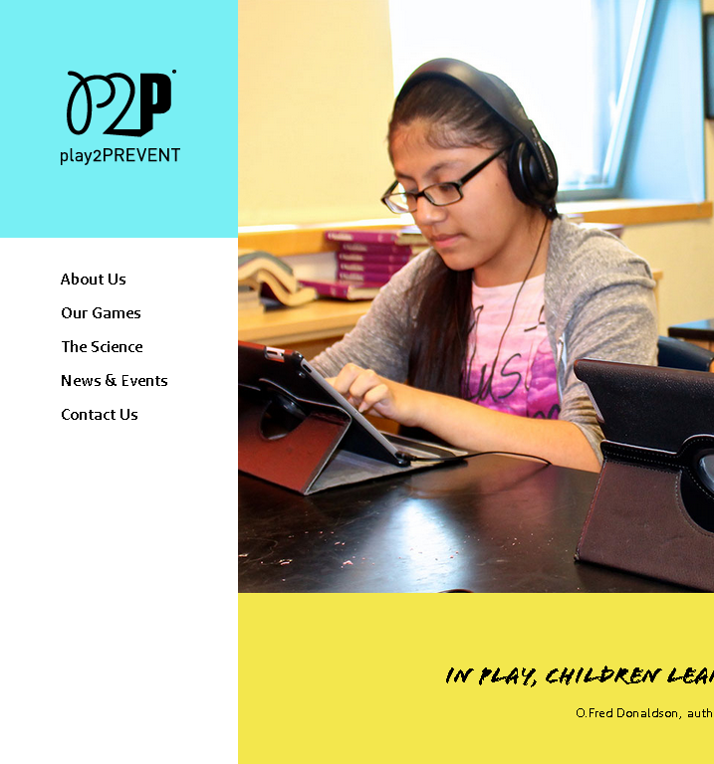
Entertainment Serious Games (All)
Serious games, defined as games with a primary purpose other than pure entertainment to educate, communicate, and improve health.*
Both active and passive mechanisms
Reviews suggested that serious games have small positive effects on health-related behaviors and their determinants but that the effect is largely fleeting.
Play2Prevent
Notes:
The Role of Enjoyment in a Serious Game for Binge Drinking Prevention: Pretest-Posttest Quasi-Experimental Study.Hong T, Cabrera J, Beaudoin CE.J Med Internet Res. 2020 Nov 30;22(11):e21652. doi: 10.2196/21652.PMID: 33252348 Free PMC article.
A Game to Deal With Alcohol Abuse (Jib): Development and Game Experience Evaluation.Carvalho DBF, Domingueti DB, Almeida Santos SM, Dias DRC.JMIR Serious Games. 2019 Oct 15;7(4):e11151. doi: 10.2196/11151.PMID: 31617849 Free PMC article.
A Motion-Activated Video Game for Prevention of Substance Use Disorder Relapse in Youth: Pilot Randomized Controlled Trial.Abroms LC, Fishman M, Vo H, Chiang SC, Somerville V, Rakhmanov L, Ruggiero M, Greenberg D.JMIR Serious Games. 2019 May 23;7(2):e11716. doi: 10.2196/11716.PMID: 31124471 Free PMC article.
Two- and three-year follow-up from a gender-specific, web-based drug abuse prevention program for adolescent girls.Schwinn TM, Schinke SP, Keller B, Hopkins J.Addict Behav. 2019 Jun;93:86-92. doi: 10.1016/j.addbeh.2019.01.010. Epub 2019 Jan 16.PMID: 30703667 Free PMC article.
Derksen, M. E., van Strijp, S., Kunst, A. E., Daams, J. G., Jaspers, M., & Fransen, M. P. (2020). Serious games for smoking prevention and cessation: A systematic review of game elements and game effects. Journal of the American Medical Informatics Association : JAMIA, 27(5), 818–833.
Derksen, M. E., van Strijp, S., Kunst, A. E., Daams, J. G., Jaspers, M., & Fransen, M. P. (2020). Serious games for smoking prevention and cessation: A systematic review of game elements and game effects. Journal of the American Medical Informatics Association : JAMIA, 27(5), 818–833.

Slide 32

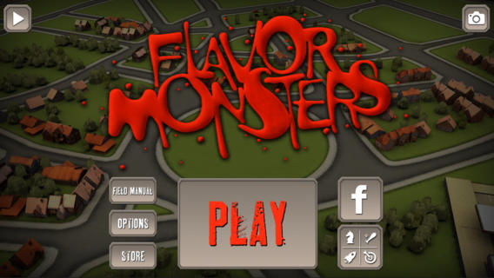
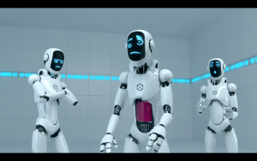
Stealth Skill Building
Night of the Gummies
Flavor Monsters
DXM Labworks
Tunnel Tail
*Use metaphors that build on key prevention concepts to reduce peer pressure
Notes:
Tunnel Tail targets adolescents 11-13 (?) years old when youth begin experimenting with alcohol, tobacco and drugs.
Early focus testing found that this age group reacts very negatively to direct reference to anything resembling "drug education."
Use metaphors that build on key prevention concepts to reduce peer pressure
“Players practice those resistance skills through repetitive game play that encourages incidental learning as they advance through the game.”

Slide 33
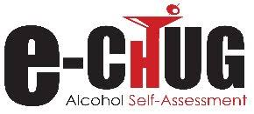
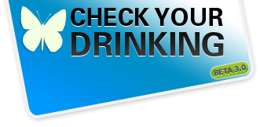

Digital Normative Feedback and Brief Personalized Feedback (Primary & Secondary)
Normative Feedback, Personalized Feedback, Costs/Consequences, Reduction Strategies
Increase problem awareness
Primarily with college students
Results are mixed and depend on numerous factors
Reviews of social norms feedback reveal little effect
Overall, personalized may be better than normative and normative should be tailored to the experiences.
Targeted (e.g. specific event) may be better
In-lab appears better than remote
Overall positive effects fleeting
Notes:
Issue you here is the norms target and one-time
Carey, K. B., Merrill, J. E., Boyle, H. K., & Barnett, N. P. (2020). Correcting exaggerated drinking norms with a mobile message delivery system: Selective prevention with heavy-drinking first-year college students. Psychology of addictive behaviors.
Bedendo A, McCambridge J, Gaume J, Souza AAL, Formigoni MLOS, Noto AR. Components evaluation of a web-based personalized normative feedback intervention for alcohol use among college students: a pragmatic randomized controlled trial with a dismantling design. Addiction. 2020 Jun;115(6):1063-1074. doi: 10.1111/add.14923. Epub 2020 Jan 27. PMID: 31785189.
Miller, M. B., Hall, N., DiBello, A. M., Park, C. J., Freeman, L., Meier, E., ... & Leffingwell, T. R. (2020). Depressive symptoms as a moderator of college student response to computerized alcohol intervention. Journal of substance abuse treatment, 115, 108038.
Powers, J. M., Zvolensky, M. J., & Ditre, J. W. (2019). An integrative review of personalized feedback interventions for pain and alcohol. Current opinion in psychology, 30, 48-53.
Neighbors, C., Rodriguez, L. M., Rinker, D. V., Gonzales, R. G., Agana, M., Tackett, J. L., & Foster, D. W. (2015). Efficacy of personalized normative feedback as a brief intervention for college student gambling: a randomized controlled trial. Journal of consulting and clinical psychology, 83(3), 500–511. https://doi.org/10.1037/a0039125
Neighbors, C., Lewis, M. A., Atkins, D. C., Jensen, M. M., Walter, T., Fossos, N., Lee, C. M., & Larimer, M. E. (2010). Efficacy of web-based personalized normative feedback: a two-year randomized controlled trial. Journal of consulting and clinical psychology, 78(6), 898–911. https://doi.org/10.1037/a0020766
"Rodriguez, L. M., Neighbors, C., Rinker, D. V., Lewis, M. A., Lazorwitz, B., Gonzales, R. G., & Larimer, M. E. (2015). Remote versus in-lab computer-delivered personalized normative feedback interventions for college student drinking. Journal of consulting and clinical psychology, 83(3), 455–463. https://doi.org/10.1037/a0039030
Walters ST, Miller E, Chiauzzi E: Wired for wellness: e-interventions for addressing college drinking. J Subst Abuse Treat 2005; 29:139–145 Crossref, Google Scholar
Riper H., van Straten A., Keuken M., Smit F., Schippers G., Cuijpers P. Curbing problem drinking with personalized-feedback interventions: a meta-analysis. Am J Prev Med 2009; 36: 247-255.
Neighbors C., Lewis M. A., Bergstrom R. L., Larimer M. E. Being controlled by normative influences: self-determination as a moderator of a normative feedback alcohol intervention. Health Psychol 2006; 25: 571-579.
Neighbors C., Lewis M. A., Atkins D. C., Jensen M. M., Walter T., Fossos N., et al. Efficacy of web-based personalized normative feedback: a two-year randomized controlled trial. J Consult Clin Psychol 2010; 78: 898-911.
In addition to the large number of brief interventions that target problematic alcohol use among college students, some brief interventions have targeted specific groups of college students, such as students turning 21 or first-year students. For example, Neighbors et al.
Cunningham J. A., Murphy M., Hendershot C. S. Treatment dismantling pilot study to identify the active ingredients in personalized feedback interventions for hazardous alcohol use: randomized controlled trial. Addict Sci Clin Pract 2014; 10: 1.
A large number of computer-delivered interventions to reduce college students’ problematic drinking have been developed. In a meta-analysis, Carey et al. (18) included 35 manuscripts with 43 separate computer-delivered interventions to reduce college students’ drinking. This meta-analysis included both intervention and prevention programs and programs that were Internet- or CD-ROM-based. Results from the meta-analysis suggest that computer-delivered interventions reduced the quantity and frequency of drinks relative to assessment-only controls. However, these computer-delivered interventions rarely differed from comparison conditions that included alcohol content. Commonly used interventions for college students’ drinking include programs such as eCHECKUP TO GO (e-CHUG), which is used by more than 600 universities and institutions (19), and Alcohol 101 Plus, which is CD-ROM based and had more than 40,000 copies distributed in 2004 (20, 21).

Slide 34
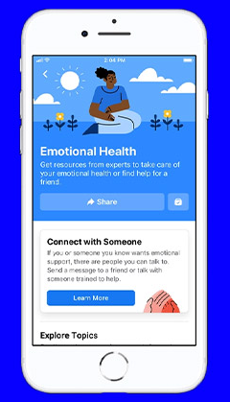
Social Connection Interventions
(Secondary & Tertiary)
Multiple Mediums with emphasis on social media sites, SMS and app based group connection.
Peers and interactive social elements
Overall efficacy of interventions that use various social connection interventions promising, but varies among target and program.
Peer Recovery Support and helplines.
Real world, real world, real world!
It is easy – anyone can do it.
(Wong et al., 2020; Gilmour et al. 2020)
Notes:
Gilmour, J., Machin, T., Brownlow, C., & Jeffries, C. (2020). Facebook-based social support and health: A systematic review. Psychology of Popular Media, 9(3), 328–346.

Slide 35
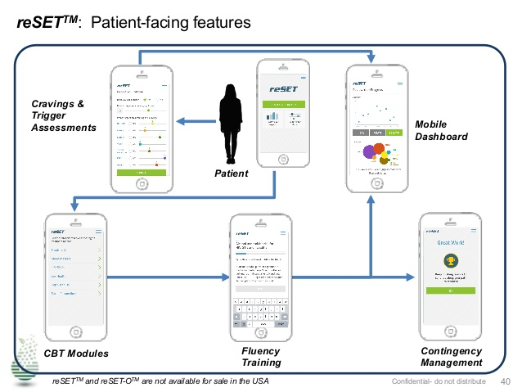
Skills Training & Role Play (Web & Apps)
CBT
Skills training
Role Play
Contingency Management
*Mostly +21
(CBT4CBT, Carroll et al; Check-up and choices, Hester et al; TES/PEAR, Marsch et al.; Dynamicare, Gastfriend et al. and many more! but few <25.
Notes:
: *MI plus skills digital role play reduce alcohol negative consequences in adolescents (Walton et al., 2010)
Bedendo A, McCambridge J, Gaume J, Souza AAL, Formigoni MLOS, Noto AR. Components evaluation of a web-based personalized normative feedback intervention for alcohol use among college students: a pragmatic randomized controlled trial with a dismantling design. Addiction. 2020 Jun;115(6):1063-1074. doi: 10.1111/add.14923. Epub 2020 Jan 27. PMID: 31785189.
Walters ST, Miller E, Chiauzzi E: Wired for wellness: e-interventions for addressing college drinking. J Subst Abuse Treat 2005; 29:139–145 Crossref, Google Scholar
Riper H., van Straten A., Keuken M., Smit F., Schippers G., Cuijpers P. Curbing problem drinking with personalized-feedback interventions: a meta-analysis. Am J Prev Med 2009; 36: 247-255.
Neighbors C., Lewis M. A., Bergstrom R. L., Larimer M. E. Being controlled by normative influences: self-determination as a moderator of a normative feedback alcohol intervention. Health Psychol 2006; 25: 571-579.
Neighbors C., Lewis M. A., Atkins D. C., Jensen M. M., Walter T., Fossos N., et al. Efficacy of web-based personalized normative feedback: a two-year randomized controlled trial. J Consult Clin Psychol 2010; 78: 898-911.
In addition to the large number of brief interventions that target problematic alcohol use among college students, some brief interventions have targeted specific groups of college students, such as students turning 21 or first-year students. For example, Neighbors et al.
Cunningham J. A., Murphy M., Hendershot C. S. Treatment dismantling pilot study to identify the active ingredients in personalized feedback interventions for hazardous alcohol use: randomized controlled trial. Addict Sci Clin Pract 2014; 10: 1.
A large number of computer-delivered interventions to reduce college students’ problematic drinking have been developed. In a meta-analysis, Carey et al. (18) included 35 manuscripts with 43 separate computer-delivered interventions to reduce college students’ drinking. This meta-analysis included both intervention and prevention programs and programs that were Internet- or CD-ROM-based. Results from the meta-analysis suggest that computer-delivered interventions reduced the quantity and frequency of drinks relative to assessment-only controls. However, these computer-delivered interventions rarely differed from comparison conditions that included alcohol content. Commonly used interventions for college students’ drinking include programs such as eCHECKUP TO GO (e-CHUG), which is used by more than 600 universities and institutions (19), and Alcohol 101 Plus, which is CD-ROM based and had more than 40,000 copies distributed in 2004 (20, 21).
Web-based CBT/Skills training* (CBT4CBT, Carroll et al; Check-up and choices, Hester et al)
Games for knowledge acquisition and engagement both active and passive (Anton et al., 2020;
Role Play: *MI plus skills digital role play reduce alcohol negative consequences in adolescents (Walton et al., 2010)
Normative feedback
General Personalized feedback

Slide 36
Sustained Engagement is a Problem
App 30-day retention by primary incorporated technique.
Closed systems require effort
Baumel, A, Muench, F, Edan, S, Kane, JM. (2019). Objective user engagement with mental health apps: systematic search and panel-based usage analysis. Journal of Medical Internet research, 21(9), e14567
Notes:
Although digital health shows promise for reaching wide AYA populations, maintaining youth engagement has been challenging. The use of mHealth apps and wearable devices generally decreases over time [4,73,101,102,104]. One study of youth aged 11–12 years found only 8% of participants were still using their wearable devices after 5 months [4]. Additional studies have reported difficulty maintaining adolescents' interest in games for health long term [105,106]. Strategies to increase long-term engagement may include pairing technology with other interventions, leveraging existing social connections, introducing new features, and creating story narratives [105,106].

Slide 37
AYA Text Messaging
Best outcomes for binge drinking
Mixed outcomes other but overall positive
Focus on commitment and goals
Proactive = high engagement
Just-in-time features highlighted
*Refer to Brian Suffoletto’s work!
MacDougall, S., Jerrott, S., Clark, S., Campbell, L. A., Murphy, A., & Wozney, L. (2021). Text Message Interventions in Adolescent Mental Health and Addiction Services: Scoping Review. JMIR Mental Health, 8(1), e16508.
Suffoletto, B., Huber, J., Kirisci, L., Clark, D., & Chung, T. (2020). The effect of SMS behavior change techniques on event-level desire to get drunk in young adults. Psychology of addictive behaviors, 34(2), 320.
Notes:
Weitzel JA, Bernhardt JM, Usdan S, et al.: Using wireless handheld computers and tailored text messaging to reduce negative consequences of drinking alcohol. J Stud Alcohol Drugs 2007; 68:534–537 Crossref, Google Scholar
MacDougall, S., Jerrott, S., Clark, S., Campbell, L. A., Murphy, A., & Wozney, L. (2021). Text Message Interventions in Adolescent Mental Health and Addiction Services: Scoping Review. JMIR Mental Health, 8(1), e16508.
Roditis, M. L., Dineva, A., Smith, A., Walker, M., Delahanty, J., D'lorio, E., & Holtz, K. D. (2020). Reactions to electronic nicotine delivery system (ENDS) prevention messages: results from qualitative research used to inform FDA’s first youth ENDS prevention campaign. Tobacco control, 29(5), 510-515.
Thompson Jr, R. G., Aivadyan, C., Stohl, M., Aharonovich, E., & Hasin, D. S. (2020). Smartphone application plus brief motivational intervention reduces substance use and sexual risk behaviors among homeless young adults: Results from a randomized controlled trial. Psychology of Addictive Behaviors.
Mason, M. J., & Coatsworth, J. D. (2020). Adolescents’ Response to a Text Message-Delivered Tobacco Use Intervention by Depressive Symptoms and Sex. Journal of Child & Adolescent Substance Abuse, 29(1), 1-9.
Chavez, K., & Palfai, T. P. (2021). Reducing Heavy Episodic Drinking among College Students Using a Combined Web and Interactive Text Messaging Intervention. Alcoholism Treatment Quarterly, 39(1), 82-95.
Carey, K. B., Merrill, J. E., Boyle, H. K., & Barnett, N. P. (2020). Correcting exaggerated drinking norms with a mobile message delivery system: Selective prevention with heavy-drinking first-year college students. Psychology of addictive behaviors.
Tucker, J. S., Linnemayr, S., Pedersen, E. R., Shadel, W. G., Zutshi, R., & Mendoza-Graf, A. (2020). Developing a text messaging-based smoking cessation intervention for young smokers experiencing homelessness. Journal of Smoking Cessation, 15(1), 35-43.
Tucker, J. S., Pedersen, E. R., Linnemayr, S., Shadel, W. G., DeYoreo, M., & Zutshi, R. (2020). A text message intervention for quitting cigarette smoking among young adults experiencing homelessness: study protocol for a pilot randomized controlled trial. Addiction science & clinical practice, 15(1), 1-13.
Suffoletto, B., Huber, J., Kirisci, L., Clark, D., & Chung, T. (2020). The effect of SMS behavior change techniques on event-level desire to get drunk in young adults. Psychology of addictive behaviors, 34(2), 320.
Bae, S., Chung, T., Dey, A. K., Ferreira, D., & Suffoletto, B. (2019, June). EXPLORING THE USE OF SMARTPHONE-BASED SENSORS TO PREDICT HEAVY DRINKING EPISODES IN YOUNG ADULTS FOR JUST-IN-TIME INTERVENTION. In ALCOHOLISM-CLINICAL AND EXPERIMENTAL RESEARCH (Vol. 43, pp. 318A-318A). 111 RIVER ST, HOBOKEN 07030-5774, NJ USA: WILEY.
Suffoletto, B., Huber, J., Kirisci, L., Clark, D., & Chung, T. (2020). The effect of SMS behavior change techniques on event-level desire to get drunk in young adults. Psychology of addictive behaviors, 34(2), 320
Suffoletto, B., Kirisci, L., Clark, D. B., & Chung, T. (2019). Which behavior change techniques help young adults reduce binge drinking? A pilot randomized clinical trial of 5 text message interventions. Addictive behaviors, 92, 161-167.
Haug, S., & Castro, R. P. (2018). Accessibility of adolescents for a mobile phone-based life-skills training program for addiction prevention. SUCHT-ZEITSCHRIFT FUR WISSENSCHAFT UND PRAXIS, 64(3), 129-139.
Bae, S., Chung, T., Ferreira, D., Dey, A. K., & Suffoletto, B. (2018). Mobile phone sensors and supervised machine learning to identify alcohol use events in young adults: Implications for just-in-time adaptive interventions. Addictive behaviors, 83, 42-47.
Jorayeva, A., Ridner, S. L., Hall, L., Staten, R., & Walker, K. L. (2017). A novel text message-based motivational interviewing intervention for college students who smoke cigarettes. Tobacco Prevention & Cessation, 3.
Tahaney, K. D., & Palfai, T. P. (2017). Text messaging as an adjunct to a web-based intervention for college student alcohol use: a preliminary study. Addictive behaviors, 73, 63-66.
Bock, B. C., Barnett, N. P., Thind, H., Rosen, R., Walaska, K., Traficante, R., ... & Scott-Sheldon, L. A. (2016). A text message intervention for alcohol risk reduction among community college students: TMAP. Addictive behaviors, 63, 107-113.
Suffoletto, B., & Chung, T. (2016). Patterns of change in weekend drinking cognitions among non–treatment-seeking young adults during exposure to a 12-week text message intervention. Journal of studies on alcohol and drugs, 77(6), 914-923.
Flett, J. A., Riordan, B. C., Scarf, D., & Conner, T. S. (2016, October). Not Like the Others: Preliminary Results from a Norms-Based Text-Message Intervention to Reduce University Students’ Drinking. In DRUG AND ALCOHOL REVIEW (Vol. 35, pp. 36-37). 111 RIVER ST, HOBOKEN 07030-5774, NJ USA: WILEY.
Scarf, D., Riordan, B. C., Flett, J. A., & Conner, T. S. (2016, October).Intervening in the Moment: Text Message Interventions Aimed at Reducing University Students’ Alcohol Consumption (Vol. 35, pp. 66-67). 111 RIVER ST, HOBOKEN 07030-5774, NJ USA: WILEY.
Mason, M. J., Mennis, J., Zaharakis, N. M., & Way, T. (2016). The dynamic role of urban neighborhood effects in a text-messaging adolescent smoking intervention. Nicotine & Tobacco Research, 18(5), 1039-1045.
Bernstein, M. H., Wood, M. D., & Erickson, L. R. (2016). The effectiveness of message framing and temporal context on college student alcohol use and problems: a selective e-mail intervention. Alcohol and alcoholism, 51(1), 106-116.
Turner, W. C., & Kamon, J. L. (2020, December). " The acceptability and feasibility of smartphone-based recovery coaching and contingency management to reduce substance use among young adults"(TD17). In ADDICTION SCIENCE & CLINICAL PRACTICE (Vol. 15, No. SUPPL 2). CAMPUS, 4 CRINAN ST, LONDON N1 9XW, ENGLAND: BMC.

Slide 38
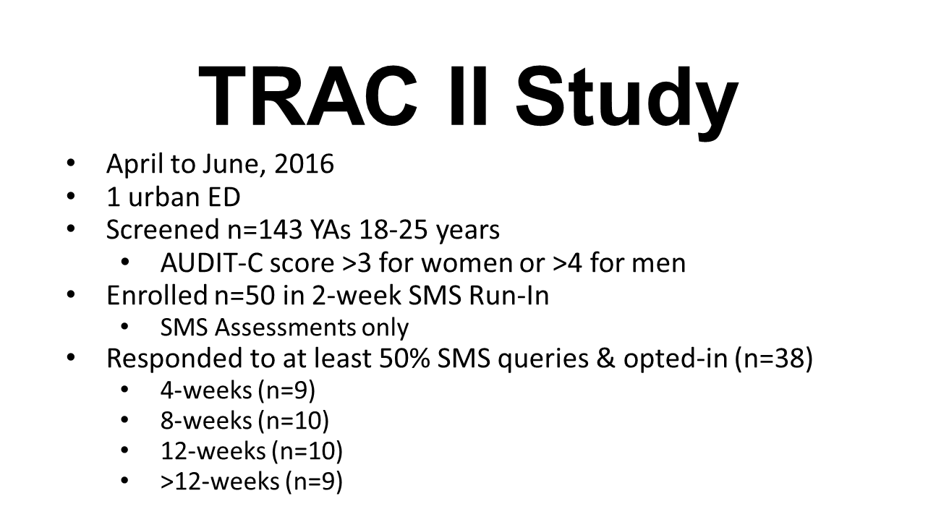
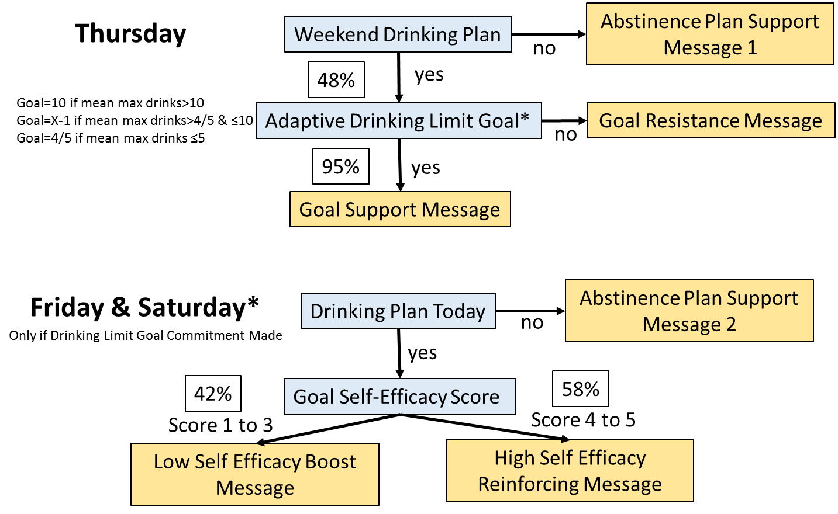
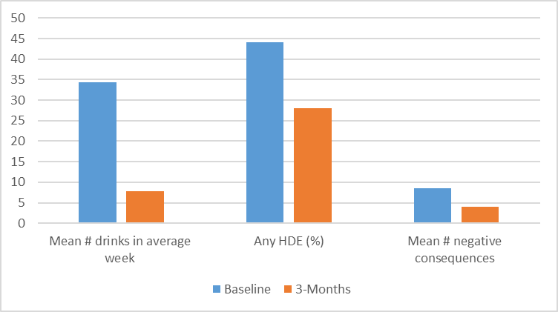
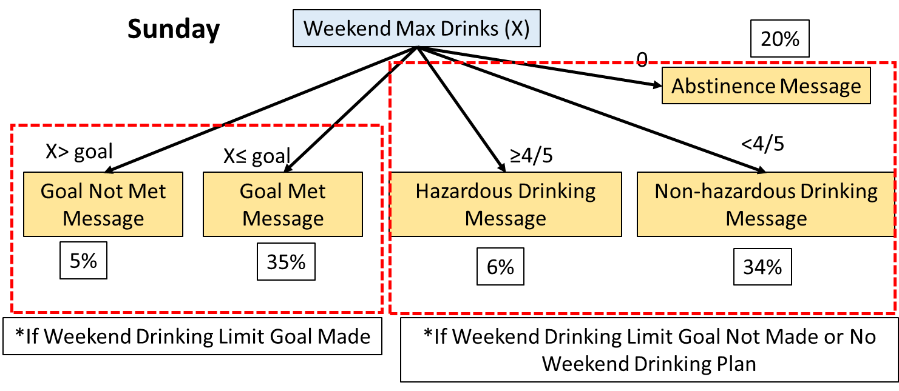

Slide 39
Conversational Agents / AI
Artificial intelligence (AI) conversational agents have the ability to offer contextual and always-available support.
    Include text based conversational agents (chatbots) and virtual avatars (animation/VR).
Studies have shown feasibility and overall positive for mental health improvements in mental health in adolescents and adults.
Addiction studies primarily smoking with good feasibility but limited overall literature base.
*Adolescents like conversational agents – they add distance and can be a great initial strategy for engagement to triage care and 24-7 care.
Vaidyam AN, Wisniewski H, Halamka JD, Kashavan MS, Torous JB. Chatbots and Conversational Agents in Mental Health: A Review of the Psychiatric Landscape. Can J Psychiatry. 2019 Jul;64(7):456-464. doi: 10.1177/0706743719828977.
Notes:
Ly KH, Ly A, Andersson G. A fully automated conversational agent for promoting mental well-being: a pilot RCT using mixed methods. Internet Interv. 2017 Dec;10:39–46. doi: 10.1016/j.invent.2017.10.002. [PMC free article] [PubMed] [CrossRef] [Google Scholar]
Fitzpatrick KK, Darcy A, Vierhile M. Delivering cognitive behavior therapy to young adults with symptoms of depression and anxiety using a fully automated conversational agent (Woebot): a randomized controlled trial. JMIR Ment Health. 2017 Jun 06;4(2):e19. doi: 10.2196/mental.7785. http://mental.jmir.org/2017/2/e19/ [PMC free article] [PubMed] [CrossRef] [Google Scholar]
@misc{simon2019using,
title={On Using Chatbots to Promote Smoking Cessation Among Adolescents of Low Socioeconomic Status},
author={Patricia Simon and Suchitra Krishnan-Sarin and Ting-Hao 'Kenneth' Huang},
year={2019},
eprint={1910.08814},
archivePrefix={arXiv},
primaryClass={cs.HC}

Slide 40
One note…
I did not talk about video-chat because it is just general therapy now

Slide 41
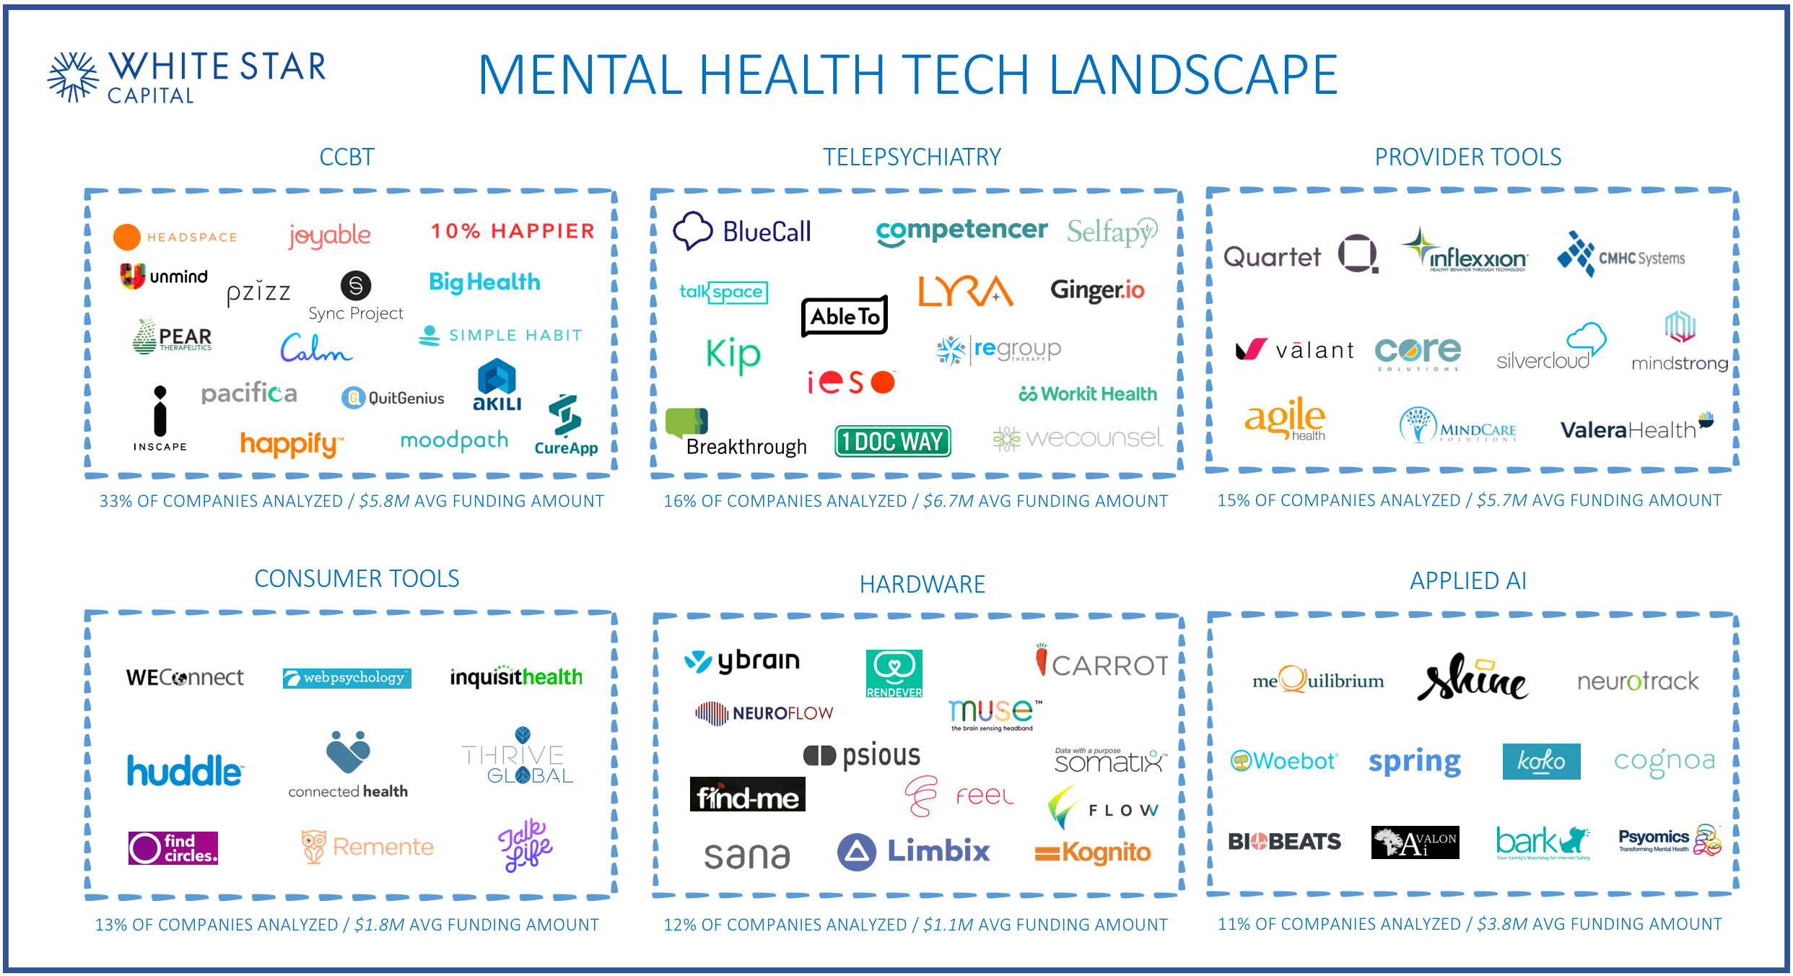
For Profit Digital Behavioral Health Companies Targeting or Allowing for Interaction with Teens and Families

Slide 42
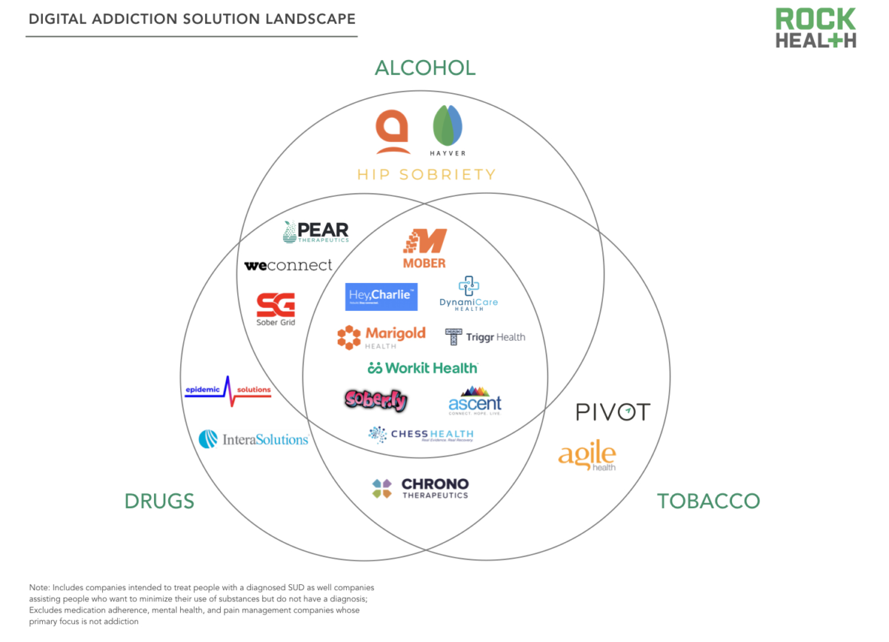
Notes:
Sober grid chess and others have support even with young people

Slide 43

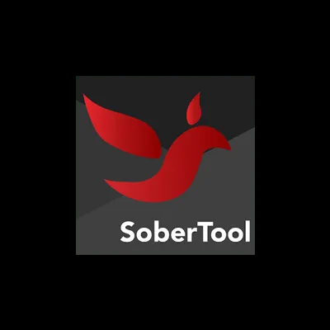
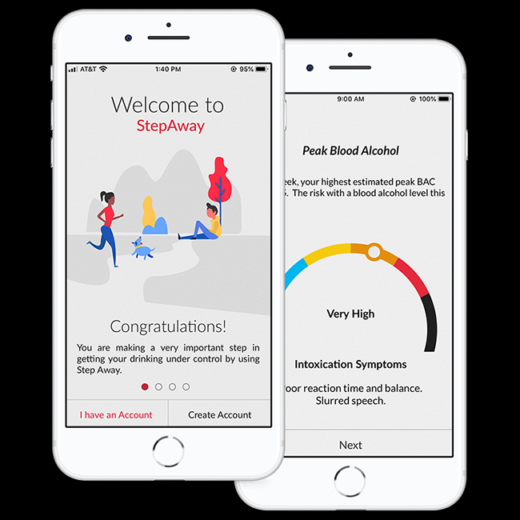



Self-Guided Apps

Slide 44
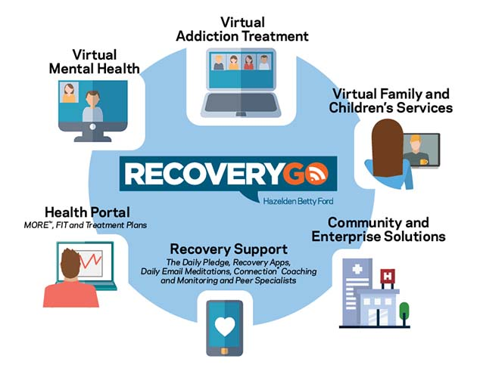
Traditional Treatment Centers are Embracing Digital
(Hazeldon, Caron, Wellbridge, etc)

Slide 45

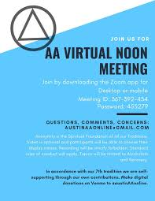
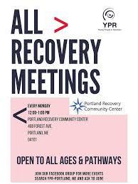
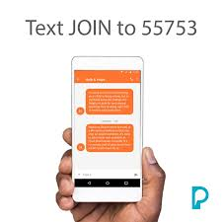

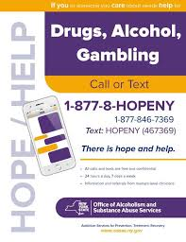
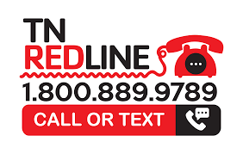

Non-Profits, States and Mutual Support Groups Are Embracing and Leveraging Technology

Slide 46
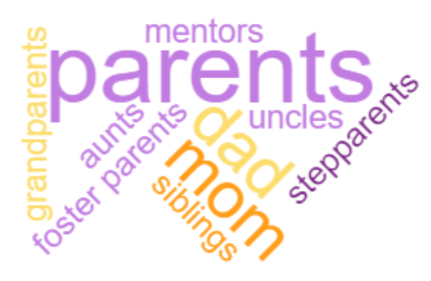
Family and Caregiver Treatments
CARER
AYA
CHILD
CHILD
Notes:
Some important points to start:
When we say “parent,” we mean: Mom, dad, grandparents, foster parents, aunts, uncles, siblings & mentors. If you're helping a child navigate life into adulthood, you are in the right place.
When we say “child,” we mean any son or daughter of any age. You never stop being your child's parent. We also mean any young person for whom an adult takes responsibility: a foster child, a grandchild, an adopted child, or sometimes a sibling.

Slide 47
Barriers to Family Engagement
A review of the barriers to family and concerned significant other focused care highlights the opportunity for digital therapies:
Trouble with travel, coordinating schedules, insufficient time, lack of resources, location barriers etc.
Stigma, family blaming, unengaged family members, prior experiences, etc.
Organizational expertise, scheduling, billing that does not reward family engagement, etc.
Alanon philosophy, ignoring relevance of concerned other.
Ignoring treating the family as the unit of intervention.
Notes:
Becker et al., 2018; Ozechowski & Waldron, 2010).
Wrape & McGinn, 2018 – differen tplaces
MacDonell et al 2017

Slide 48
Parent and Family Training
Limited empirical literature for addiction prevention and SUD digital interventions for parents and families.
Large literature on online digital parent training for childhood disruptive disorders.
  Overall effective for both self-care and child symptoms
Telehealth / video chat literature more prevalent for parent and family mental health care.
Provider and peer phone based interventions effective
Emerging literature on text messaging to increase parental self-efficacy and care in mental health.
Large window of opportunity!
Notes:
Jansen R, Reid M. Communication Technology Use by Caregivers of Adolescents With Mental Health Issues: Systematic Review. JMIR Mhealth Uhealth. 2020 Aug 19;8(8):e13179.

Slide 49
Family / Caregiver Digital Intervention References
Jansen R, Reid M. Communication Technology Use by Caregivers of Adolescents With Mental Health Issues: Systematic Review. JMIR Mhealth Uhealth. 2020 Aug 19;8(8):e13179.
Thongseiratch, T., Leijten, P. & Melendez-Torres, G.J. Online parent programs for children’s behavioral problems: a meta-analytic review. Eur Child Adolesc Psychiatry 29, 1555–1568 (2020).
Harris, M., Andrews, K., Gonzalez, A. et al. Technology-Assisted Parenting Interventions for Families Experiencing Social Disadvantage: a Meta-Analysis. Prev Sci 21, 714–727 (2020).
Chu JTW, Wadham A, Jiang Y, et al. Effect of MyTeen SMS-Based Mobile Intervention for Parents of Adolescents: A Randomized Clinical Trial. JAMA Netw Open. 2019;2(9):e1911120.
Wrape, E. R., & McGinn, M. M. (2019). Clinical and ethical considerations for delivering couple and family therapy via telehealth. Journal of Marital and Family Therapy, 45, 296-308.
Carpenter, K. M., Foote, J., Hedrick, T., Collins, K., & Clarkin, S. (2020). Building on shared experiences: The evaluation of a phone-based parent-to-parent support program for helping parents with their child’s substance misuse. Addictive Behaviors, 100.
Hogue, A., Becker, S. J., Fishman, M., Henderson, C. E., & Levy, S. (2021). Youth OUD treatment during and after COVID: Increasing family involvement across the services continuum. Journal of Substance Abuse Treatment. DOI: 10.1016/j.jsat.2020.108159

Slide 50

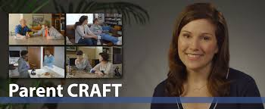
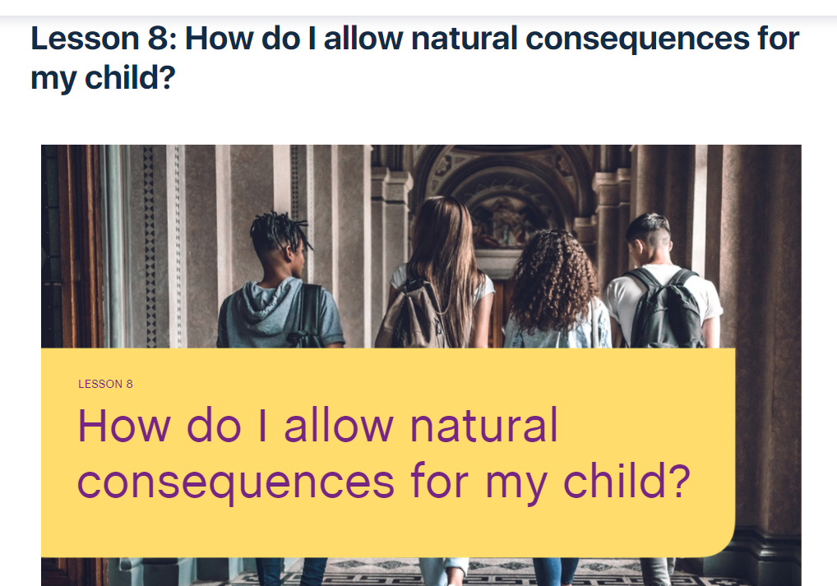
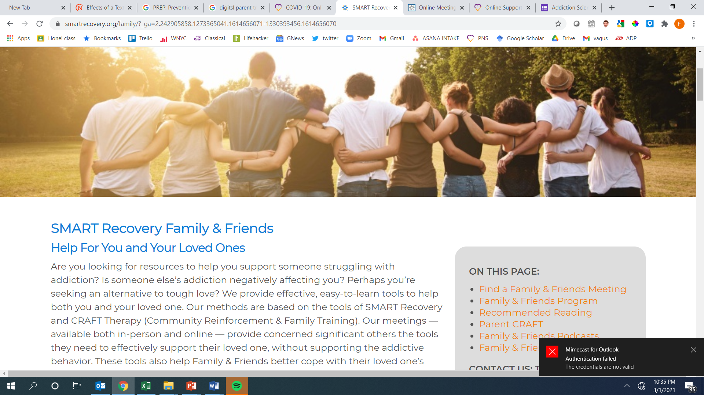
Consumer Programs (Prevention & Intervention)

Slide 51






Partnership Consumer Programs
  Helpline
  Bilingual specialists provide support, guidance and resources
  Personalized plan for your family
Drugfree.org
Science-based
information and resources to help you and your family
Guides, e-books, videos and more
Help & Hope by Text
Personalized and supportive messages sent straight to your mobile device
E-Learning
Self-paced course addressing teen substance use
10 lessons strengthen parenting skills and offer tools and strategies
Peer Parent Coaching
Work one-on-one with a peer parent coach who has "been there" and can relate to your family's experience with substance use
Online Support Community
Live online gatherings hosted by Peer Parent Coaches
Opportunity to
find support and connection
*Note: Does not include our provider training technical assistance programming for families
Notes:
The Partnership has built a suite of resources to help parents.
Helpline
Support, guidance and resources provided by our bilingual helpline specialists
Develop a personalized plan for your family
Drugfree.org
Your source for science-based information and resources to help you help your family
Find guides, e-books, videos and more
Help & Hope by Text: Receive supportive messages in addition to concrete information and resources sent straight to your mobile device
E-Learning
A self-paced course that's a playbook for how to handle teen substance use using select parenting tools and strategies
10 lessons to strengthen parenting skills to address
Peer Parent Coaching
Parents work one-on-one, by phone, with a peer parent coach who has been there and can relate to what you’re experiencing
Online Support Community
Live online gatherings hosted by Peer Parent Coaches
Opportunity to find support and connection

Slide 52









The Support Journey
Multi-channel
Engagement
Assess
Curate
(Feedback)
Synchronous & Asynchronous
Automated & Human Support
Adapt
Localize
Personalize to each person’s unique needs with immediate and ongoing feedback
Preferred Mode of Communication (Phone, video-chat, SMS, Chat, Facebook, Whats App)
Adapt through ongoing assessment that changes the program with the changing needs
Embedded referrals to in-person services
Passive & Active Assessment
Notes:
Text messaging
Health
Parenting
Kids
Risk behaviors
Schools
Teachers

Slide 53
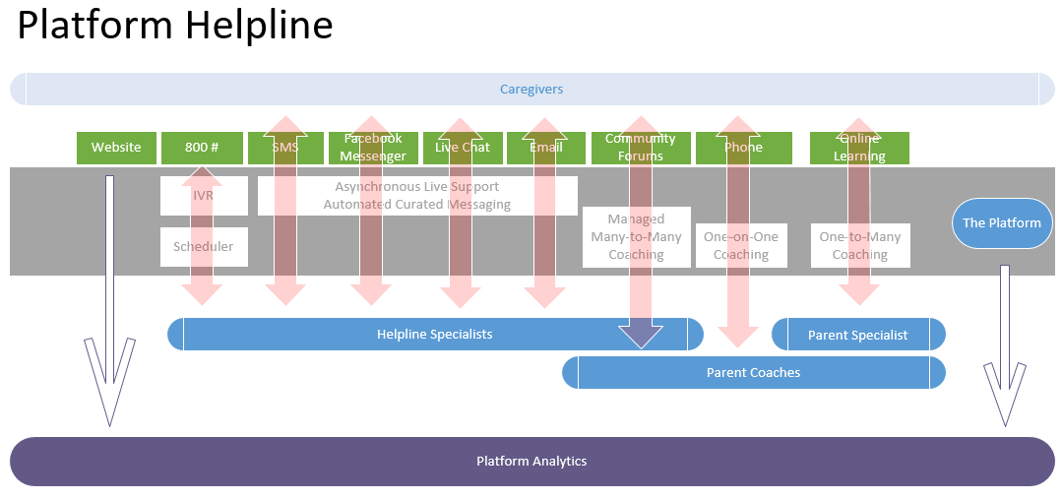
Omni-Channel Communication
Partnership Helpline Example
Notes:
People come to us through multiple channels, represented here by the green rectangles. All of these channels are integrated into one piece of technology on our end, through a program that we call the Platform.
No matter how the families connect with us, our Helpline Specialists or our Parent Coaches are seeing this information in the same interface. In addition, all of the data are being collected in one location and we can easily use this to analyze outcomes.
One of the most important things about our system is that it allows families to adapt our support to wherever they are in their help-seeking journey, we “meet the family where the family is.”
A parent who prefers a low-threshold engagement with us can download an e-Book from our website without ever engaging with a live human being. A parent who wants to chat with a Helpline Specialist, a professional clinician, in real time can do that via text or Facebook Messenger. A parent who prefers a group format for support can join our Online Learning Community. A parent who wants a one-on-one experience with a Peer Parent Coach can receive support from a peer in this particular way. They look at our menu of options and choose the service or services that are the right fit for them.

Slide 54
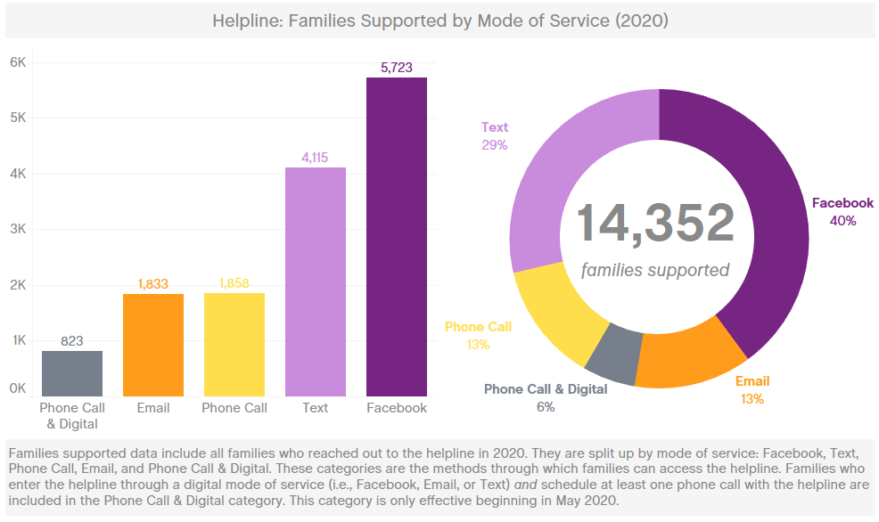
Notes:
Shankar

Slide 55
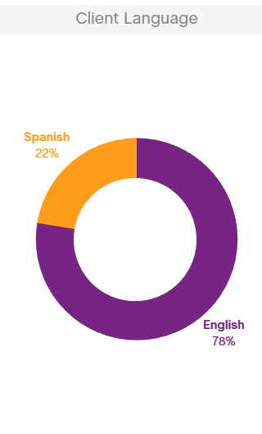
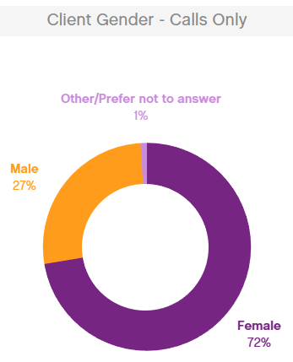
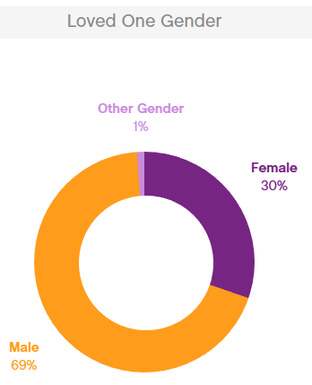



2020 Helpline Stats (Sample Only)

Slide 56
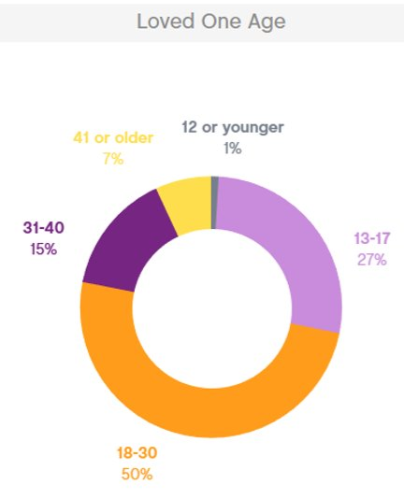
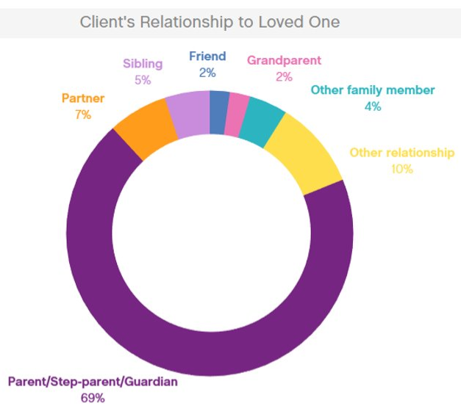
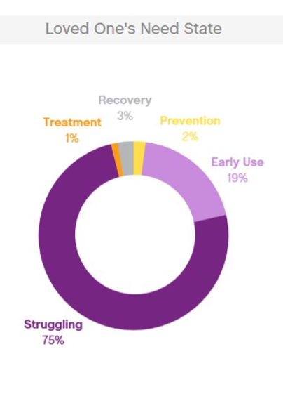



2020 Helpline Stats (Sample Only)

Slide 57
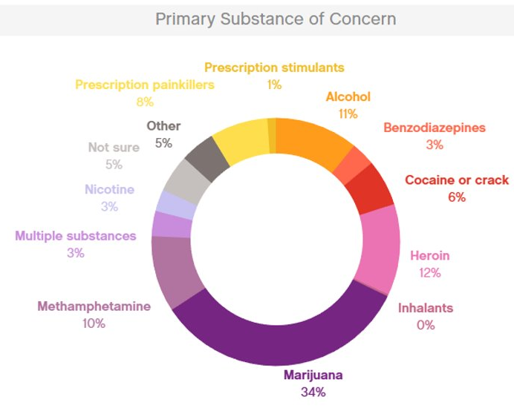
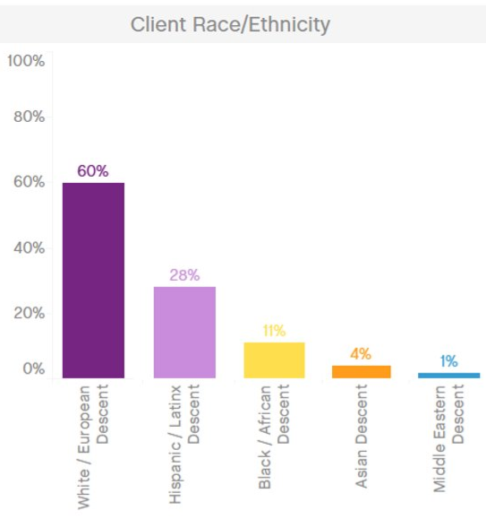


2020 Helpline Stats (Sample Only)

Slide 58
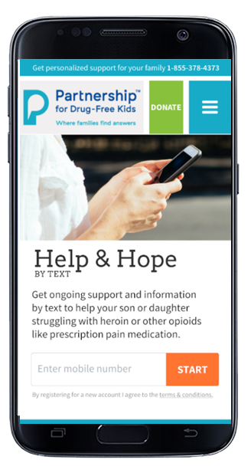
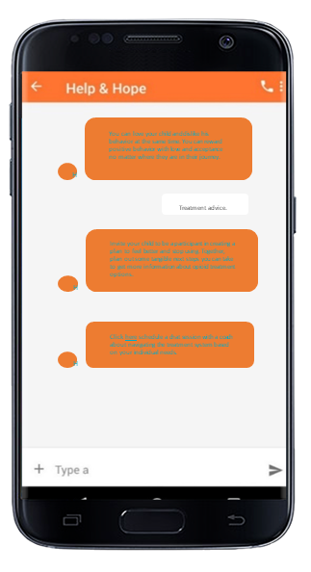
Help & Hope Mobile Intervention
Text "JOIN" to 55753 to start receiving messages
Personalized feedback and mobile messaging from prevention to recovery (some in beta)

Slide 59
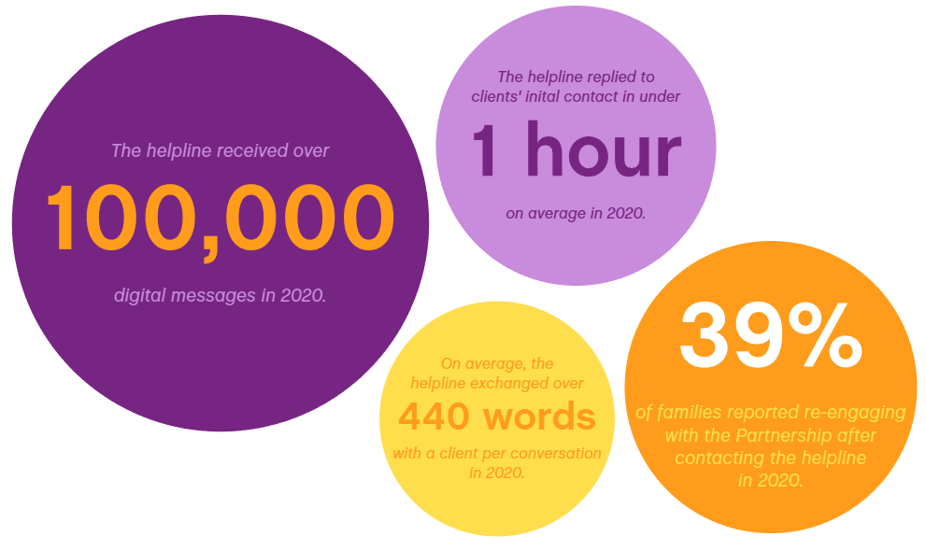
27%
of clients receiving automated messages texted “chat” to connect with a specialist.

Slide 60
Suggestions for Integration into Practice
Review the literature
Then, question the literature
Then, try it yourself and don’t cheat
Then, try it with the target population
  Then try it with your population when nobody cares about it happening (e.g. no monitoring or incentives).

Slide 61
Other References Cited
Watkins, L. E., & Sprang, K. (2018). An overview of Internet-and smartphone-delivered interventions for alcohol and substance use disorders. Focus, 16(4), 376-383.
Calvo, R., Milne, D., Hussain, M., & Christensen, H. (2017). Natural Language Processing In Mental Health Applications Using Non-clinical Texts. Natural Language Engineering, 23(5), 649-685.
Derksen, M. E., van Strijp, S., Kunst, A. E., Daams, J. G., Jaspers, M., & Fransen, M. P. (2020). Serious games for smoking prevention and cessation: A systematic review of game elements and game effects. Journal of the American Medical Informatics Association : JAMIA, 27(5), 818–833
The Role of Enjoyment in a Serious Game for Binge Drinking Prevention: Pretest-Posttest Quasi-Experimental Study.Hong T, Cabrera J, Beaudoin CE.J Med Internet Res. 2020 Nov 30;22(11):e21652.
Carey, K. B., Merrill, J. E., Boyle, H. K., & Barnett, N. P. (2020). Correcting exaggerated drinking norms with a mobile message delivery system: Selective prevention with heavy-drinking first-year college students. Psychology of addictive behaviors.
Bedendo A, McCambridge J, Gaume J, Souza AAL, Formigoni MLOS, Noto AR. Components evaluation of a web-based personalized normative feedback intervention for alcohol use among college students: a pragmatic randomized controlled trial with a dismantling design. Addiction. 2020 Jun;115(6):1063-1074. doi: 10.1111/add.14923. Epub 2020 Jan 27. PMID: 31785189.
Gilmour, J., Machin, T., Brownlow, C., & Jeffries, C. (2020). Facebook-based social support and health: A systematic review. Psychology of Popular Media, 9(3), 328–346.
Tucker, J. S., Pedersen, E. R., Linnemayr, S., Shadel, W. G., DeYoreo, M., & Zutshi, R. (2020). A text message intervention for quitting cigarette smoking among young adults experiencing homelessness: study protocol for a pilot randomized controlled trial. Addiction science & clinical practice, 15(1), 1-13.
Suffoletto, B., Huber, J., Kirisci, L., Clark, D., & Chung, T. (2020). The effect of SMS behavior change techniques on event-level desire to get drunk in young adults. Psychology of addictive behaviors, 34(2), 320.
Bae, S., Chung, T., Dey, A. K., Ferreira, D., & Suffoletto, B. (2019, June). EXPLORING THE USE OF SMARTPHONE-BASED SENSORS TO PREDICT HEAVY DRINKING EPISODES IN YOUNG ADULTS FOR JUST-IN-TIME INTERVENTION. In ALCOHOLISM-CLINICAL AND EXPERIMENTAL RESEARCH (Vol. 43, pp. 318A-318A). 111 RIVER ST, HOBOKEN 07030-5774, NJ USA: WILEY.
Suffoletto, B., Kirisci, L., Clark, D. B., & Chung, T. (2019). Which behavior change techniques help young adults reduce binge drinking? A pilot randomized clinical trial of 5 text message interventions. Addictive behaviors, 92, 161-167.
Haug, S., & Castro, R. P. (2018). Accessibility of adolescents for a mobile phone-based life-skills training program for addiction prevention. SUCHT-ZEITSCHRIFT FUR WISSENSCHAFT UND PRAXIS, 64(3), 129-139.
Bae, S., Chung, T., Ferreira, D., Dey, A. K., & Suffoletto, B. (2018). Mobile phone sensors and supervised machine learning to identify alcohol use events in young adults: Implications for just-in-time adaptive interventions. Addictive behaviors, 83, 42-47.
Jorayeva, A., Ridner, S. L., Hall, L., Staten, R., & Walker, K. L. (2017). A novel text message-based motivational interviewing intervention for college students who smoke cigarettes. Tobacco Prevention & Cessation, 3.
Vaidyam AN, Wisniewski H, Halamka JD, Kashavan MS, Torous JB. Chatbots and Conversational Agents in Mental Health: A Review of the Psychiatric Landscape. Can J Psychiatry. 2019 Jul;64(7):456-464. doi: 10.1177/0706743719828977.

Slide 62
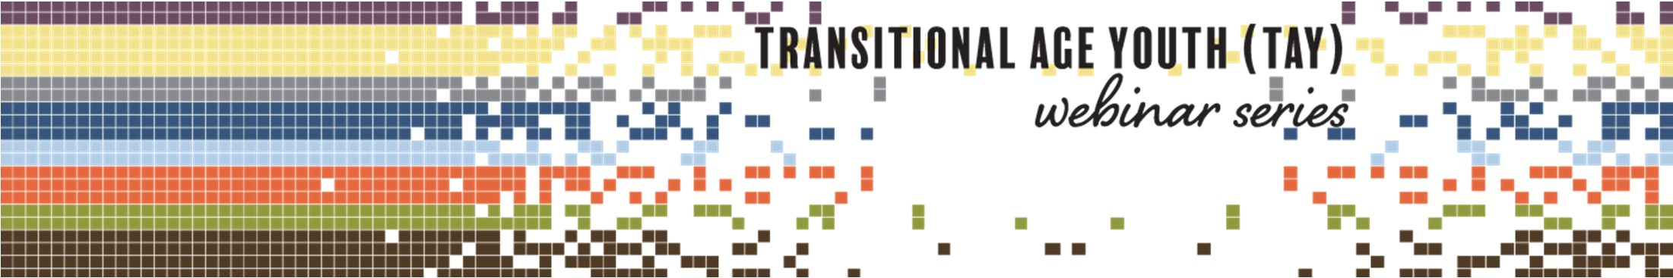

Thank you
fmuench@toendaddiction.org
Produced in Partnership:
attcnetwork.org/centers/global-attc/tay-webinar-series

Slide 63

Related Products & Resources
from the ATTC Network
CLAS Standards in Behavioral Health: Working with Youth and Adolescents (Recorded webinar)
Understanding Latino Youth Recovery: Issues, Assets and Creating Resiliency (Recorded webinar)
Adolescent Brain Maturation and Health: Intersections on the Developmental Highway
  Recorded presentation
  Handouts
Effects on Marijuana Use on Developing Adolescents (Recorded webinar)
Vaping Overview and CATCH My Breath Program (Recorded webinar)
Vaping 2: Education vs Punishment Using Deferred Citation (Recorded webinar)
Understanding Suicide Part 2 Adolescents and the Changing Brain (Recorded webinar)
attcnetwork.org/centers/global-attc/tay-webinar-series
Notes:
To augment the information provided today, you can check out these additional resources from the ATTC and PTTC Networks.

Slide 64

Related Products & Resources
from the PTTC Network
Underage Alcohol Use: An Overview of Data and Strategies (Recorded webinar)
Youth Opioid Addiction: What Preventionists Need to Know (Recorded webinar)
Selecting and Implementing Evidence-Based Practices to Address Substance Misuse Among Young Adults: Webinar on SAMHSA’s Resource Guide
Preventing Youth Vaping (Webinar Series) Part 1 of 2: The Extent and Risk Factors for Youth Vaping (Recorded webinar)
Preventing Youth Vaping Part 2 of 2: Policy Recommendations and Promising Practices for Addressing Youth Vaping (Recorded webinar)
The Benefits of Engaging Youth in Communities: Insights and Evidence from Developmental Science (Recorded webinar)
Vaping and LGBTQ Youth (Recorded webinar)
Informing Prevention 6-Part Webinar Series on Adolescents: Mountain Plains PTTC
Adolescent SBIRT Pocket Card
attcnetwork.org/centers/global-attc/tay-webinar-series

Slide 65



Keep in Touch with
the AMERSA Network
For more information about AMERSA visit: www.amersa.org
Join our mailing list: https://amersa.org/contact-us/
@AMERSA_tweets
@AMERSA2021
amersa.org/resources/tay-webinar-series/
Notes:
You can also keep in touch with ATTC, NORC and AMERSA via their newsletters and social media. Sign up now for monthly emails and follow them on Twitter and Facebook.

Slide 66

Keep in Touch with
the ATTC Network
ATTC Network Office publishes the Messenger monthly
  Subscribe: https://attcnetwork.org/centers/global-attc/subscribe-attc-messenger
@ATTCnetwork
@attcNetwork
attcnetwork.org/centers/global-attc/tay-webinar-series

Slide 67

Keep In Touch with
the PTTC Network
PTTC Network Office publishes the PTTC POST monthly
  Subscribe:
  https://pttcnetwork.org/centers/global-pttc/pttc-subscription-page
@PTTCnetwork
@PreventionTTCnetwork
attcnetwork.org/centers/global-attc/tay-webinar-series

Slide 68
Digital Mental Health and Addiction Interventions for Adolescents, Young Adults and Families
Produced in Partnership:
Notes:
And, with that, I thank you so much for attending and will now conclude today’s webinar. We hope you will view all of the episodes in this Transitional Age Youth series.

